Slide 1



Testing Guide
Sveaverken Alva
Robotic Lawn Mower
https://www.sveaverken.com/products/sveaverken-alva-4g-wireless-robotic-lawn-mower-rtk-vision
Copyright © Sveaverken Rights Reserved.

Slide 2
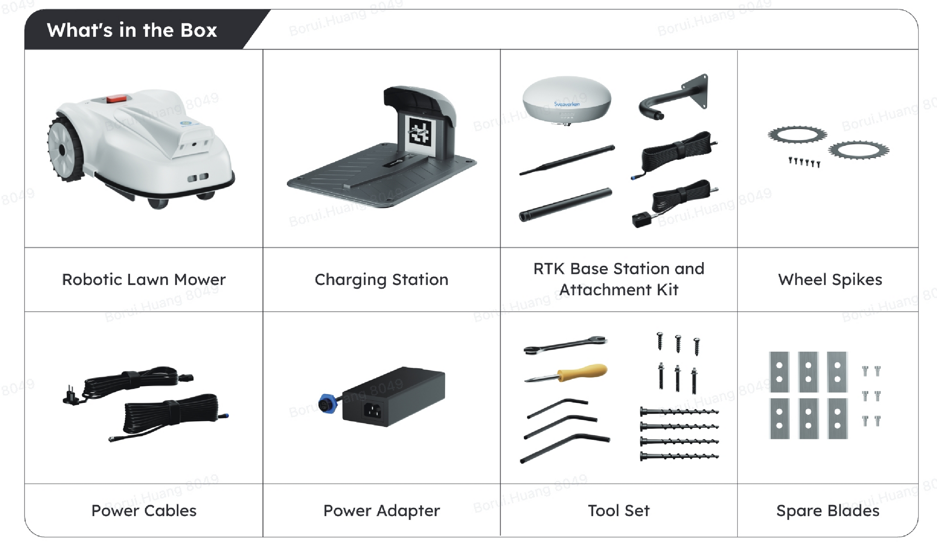
In the Box
As soon as you receive the box, please contact FAE for recorded unboxing and installation guidance
Robotic Lawn Mower
Charging Station
RTK Base Station and Attachment Kit
Wheel Spikes
Power Cables
Power Adapter
Tool Set
Spare Blades

Slide 3


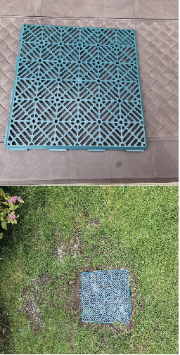
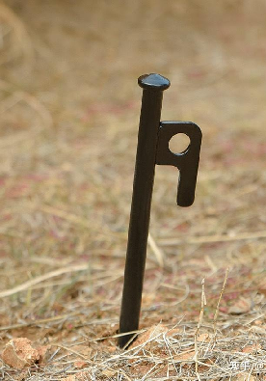
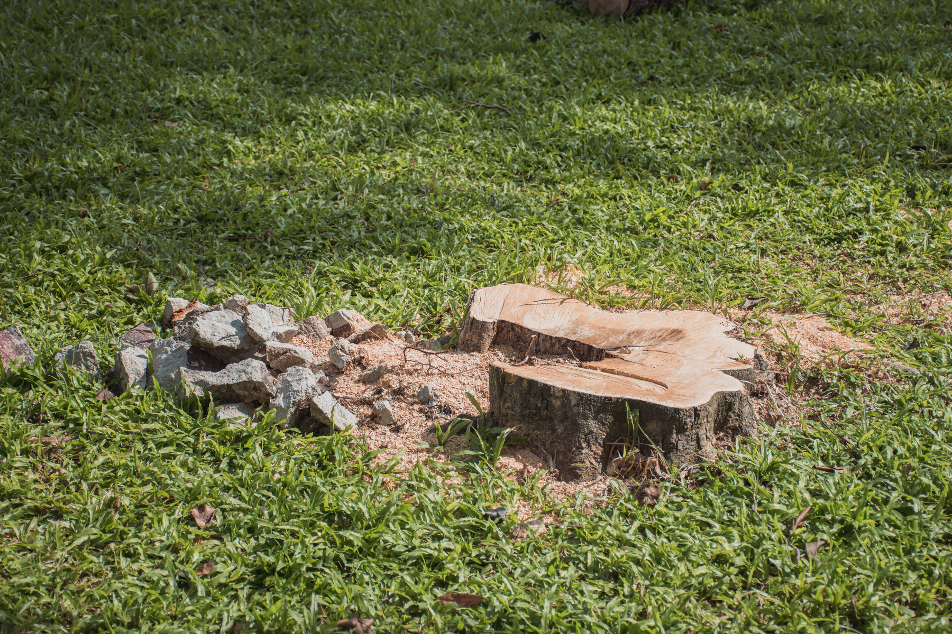
Lawn Check
Safety First
Before using the mower, walk your lawn and remove any visible objects.
Clear the mowing area of rocks, large twigs, tree branches, or goalposts that might block the mower before mowing tasks.
Remove low-lying rocks and other hard objects in the grass to avoid damage to the mower blades.
For muddy patches or holes, level the ground first: fill and reseed, use plastic grid tiles that grass can grow through, or lay down anti-slip mats to improve traction and reduce the risk of the mower getting stuck.
Keep pets and children away from the lawn when the mower is working.

Slide 4
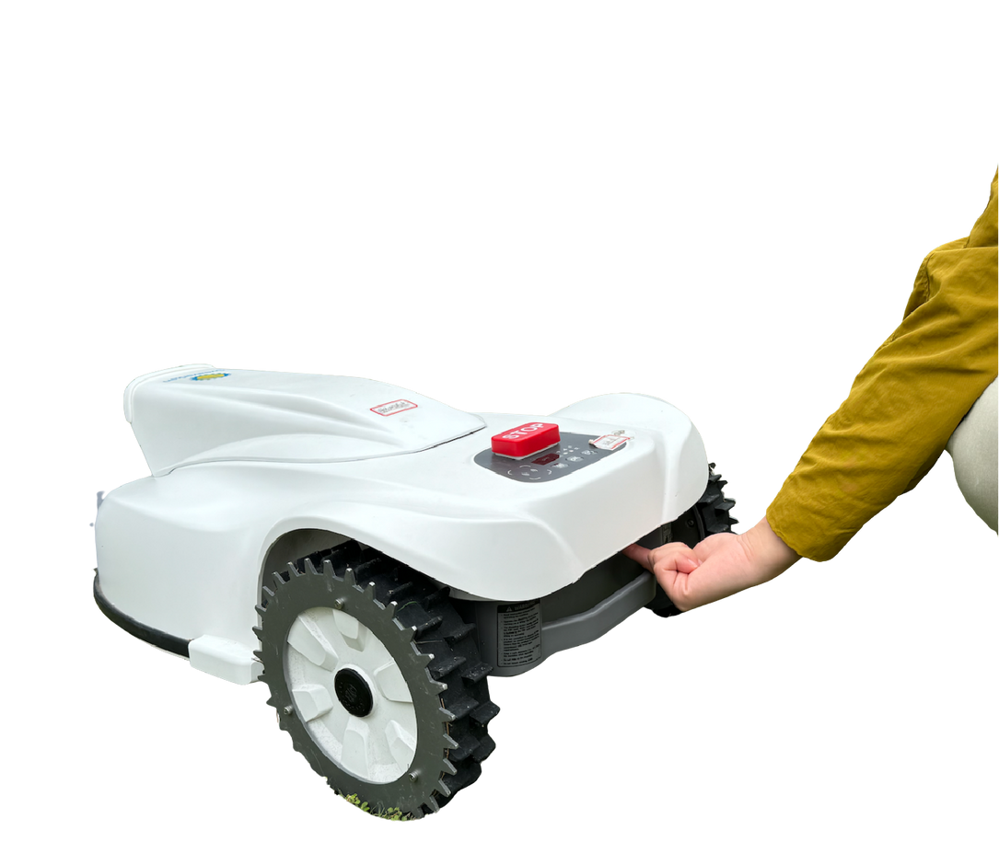
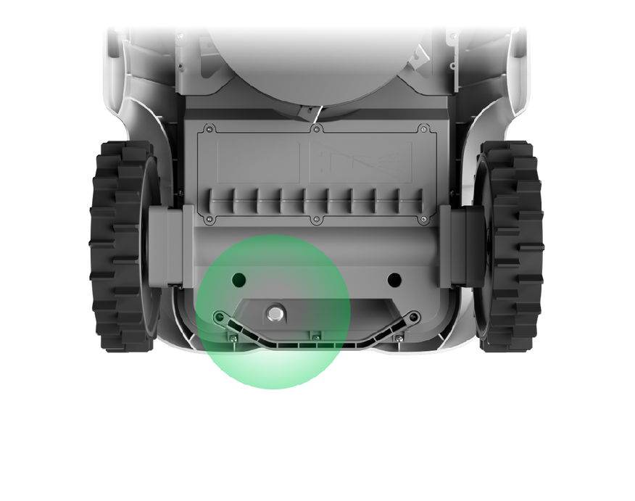
1.
Turn the Mower on
Press the power button on the bottom of the mower
Power button at the bottom of the mower

Slide 5
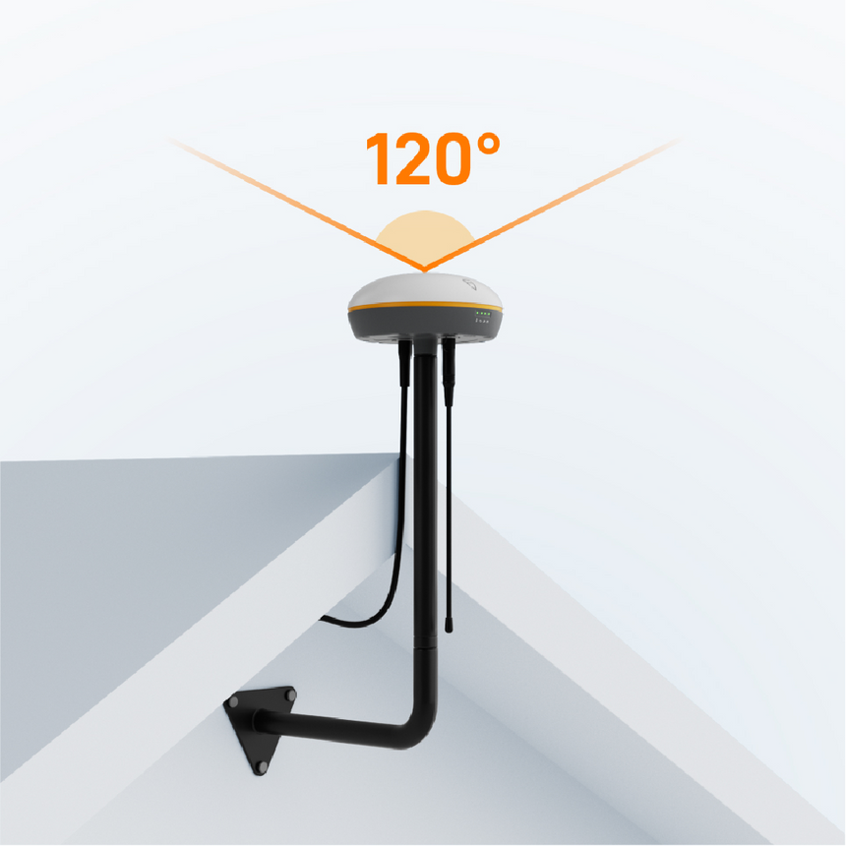
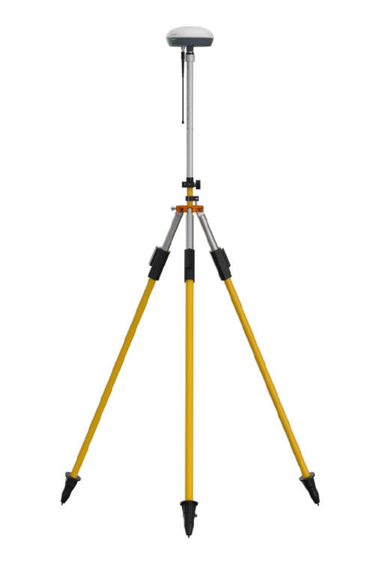
2.
Set up RTK Base Station
Find an ideal location for the RTK base station
  Ideally, mount the RTK base station on a wall or roof with a clear view of the sky.
  If this is not possible, choose a flat, open area with no trees or buildings within 10 m (35 ft) and install the RTK antenna on a tripod.
  Ensure there is at least 120° of unobstructed sky above the RTK base station.
  Keep the antenna away from cell towers, high-voltage power lines, and large bodies of water (e.g., lakes), as they may interfere with satellite reception. A minimum distance of 500 m (1,600 ft) is recommended.
Note: Do not connect power to the RTK base station while you are positioning it.

Slide 6
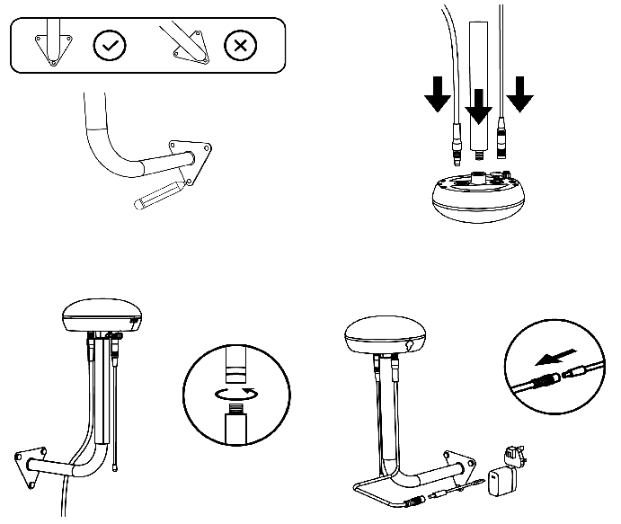
2.
Set up RTK Base Station
Install the RTK base station and ensure it is firmly mounted
1
Fix the mount or tripod and keep the base station upright. Make sure the antenna is pointing straight toward the sky for optimal performance.
2
Plug the power cable into the RTK base station and twist on the radio antenna.
3
Attach the RTK base station to the mount or tripod
4
Connect to power

Slide 7
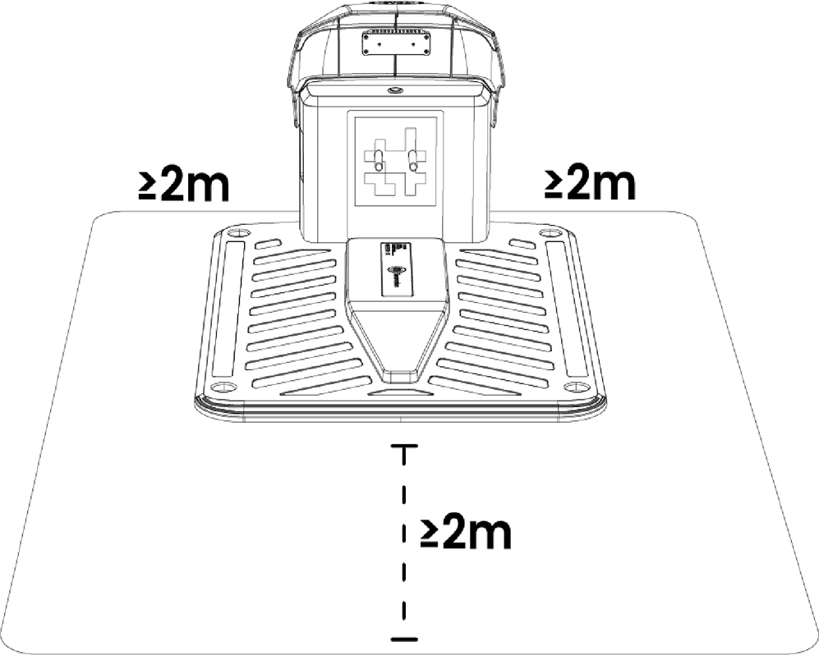
3.1
Install Charging Station
Place the charging station in a clear, flat spot with indoor power so your mower can charge and dock smoothly
  Secure the charging station to the ground or into the garden soil using the supplied pegs.
  Place the charging station on a flat area with a clear view of the sky and access to a power outlet. Avoid walls and trees that can weaken the RTK signal; if RTK is compromised, the mower will switch to visual navigation.
  Keep at least a 2 m (6 ft) clear area around the charging station so the mower has enough space to dock and return home accurately.
  The power adapter is rated for indoor use only. Use a weather-resistant extension cord to connect the charging station to an indoor outlet.

Slide 8
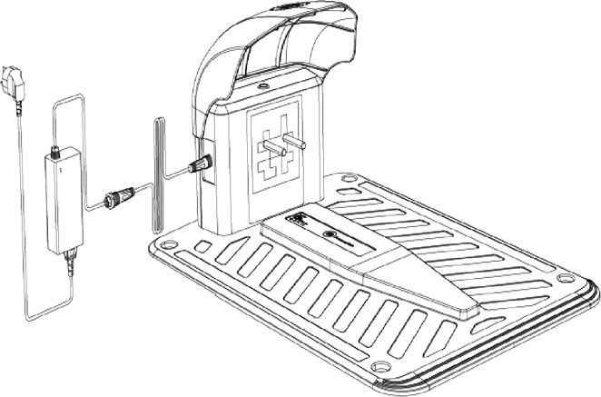
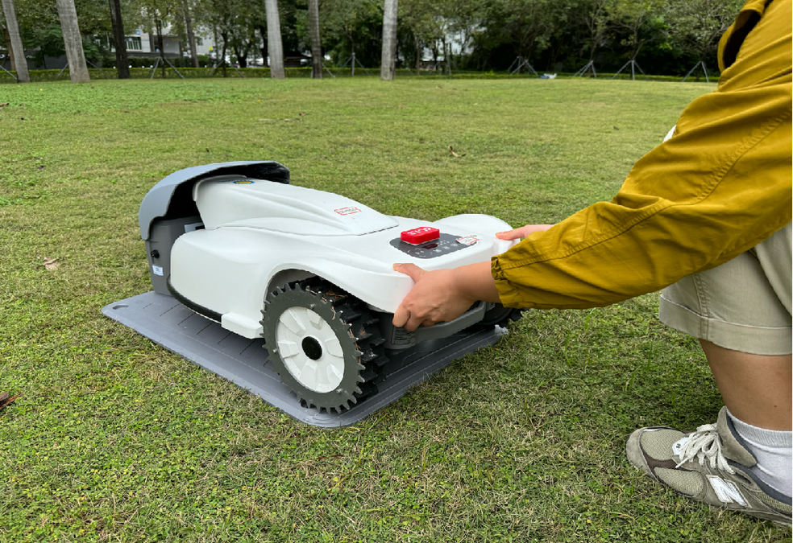
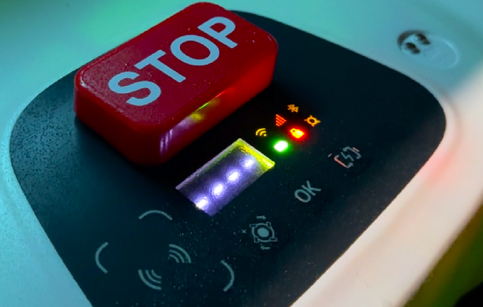
3.2
Charge the Mower
Dock the mower and let it charge
1
Connect the charging station to power
2
Press the STOP button, then roll the mower onto the charging station.
3
Check the battery light — a blinking green light means your mower is charging.

Slide 9
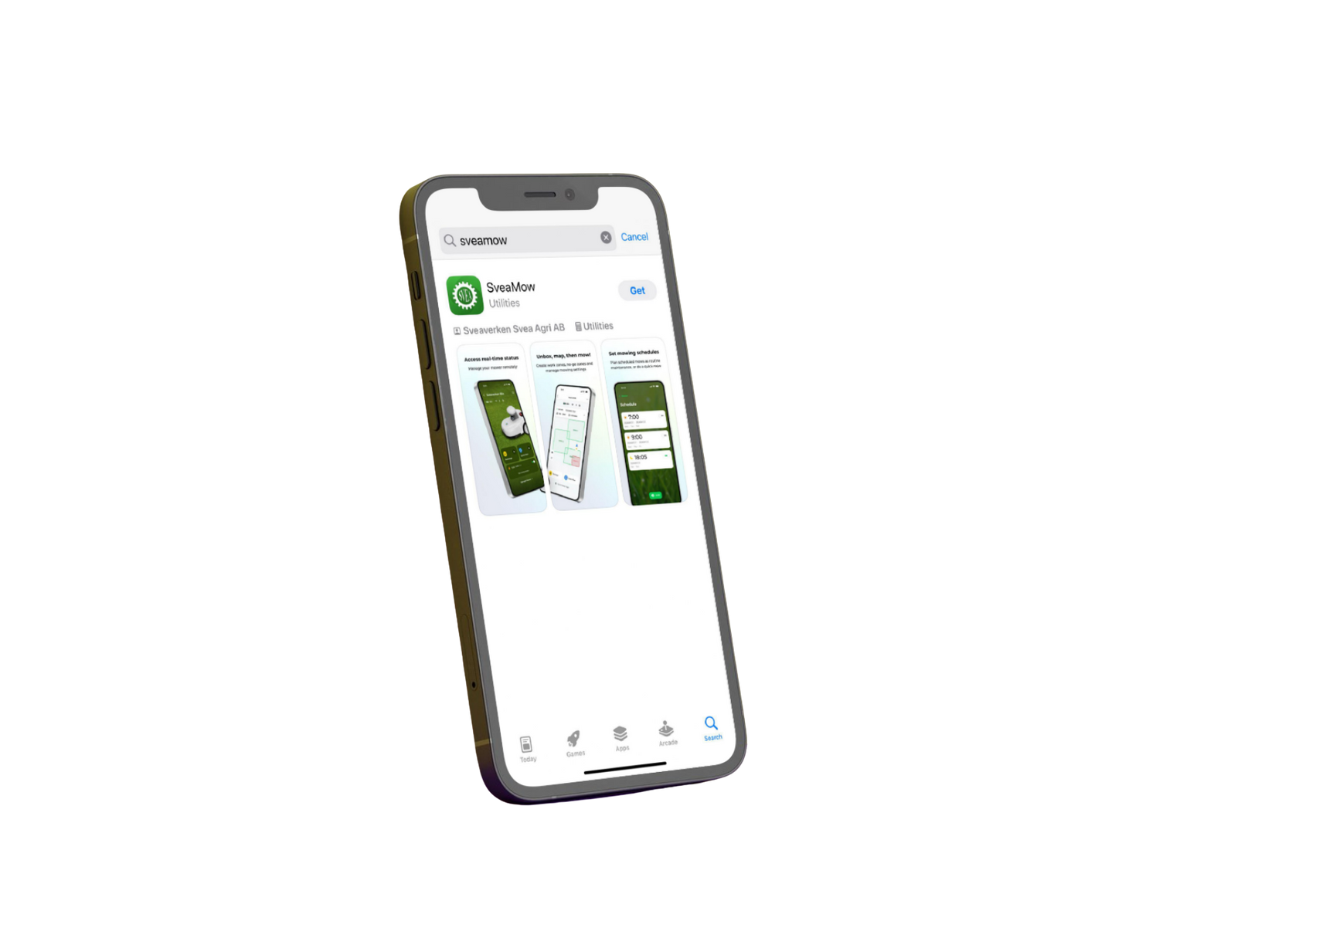
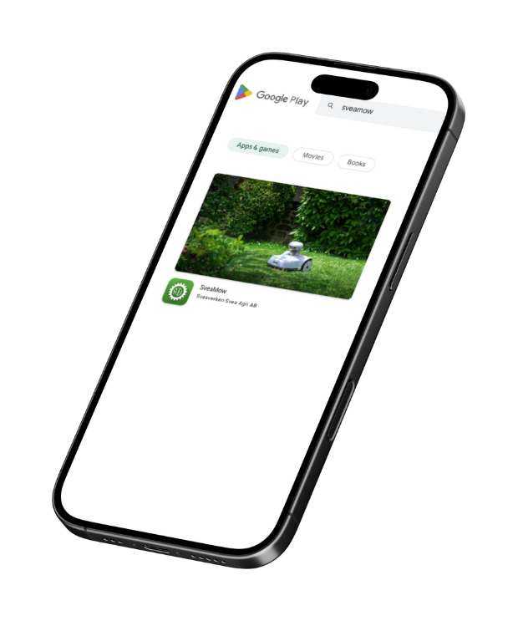



4.
Software Setup
Meet SveaMow
Your Smart Lawn Care Companion

Slide 10
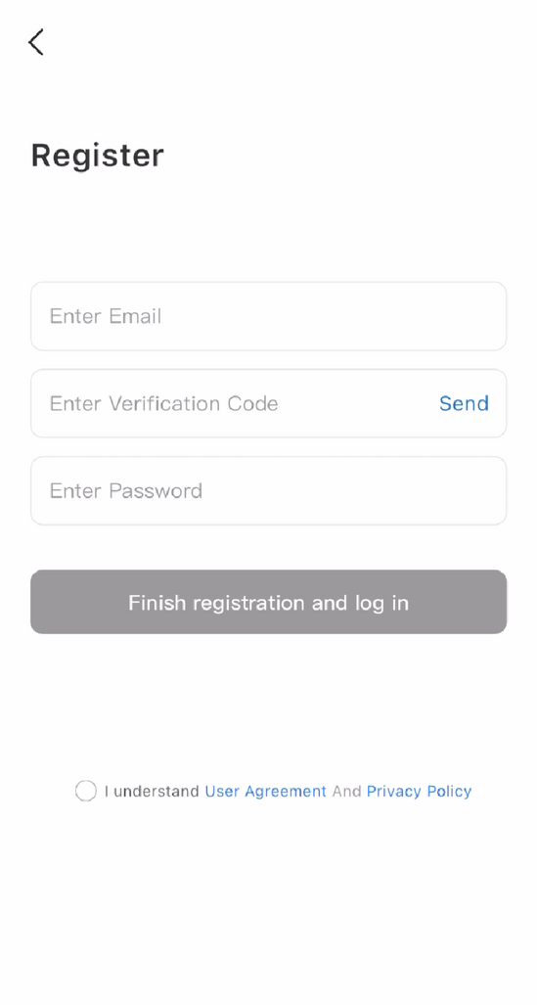
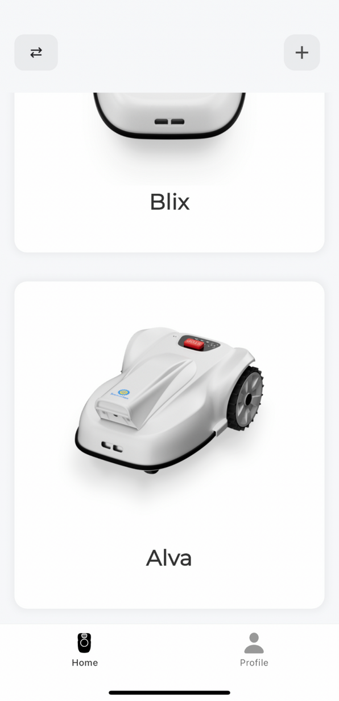
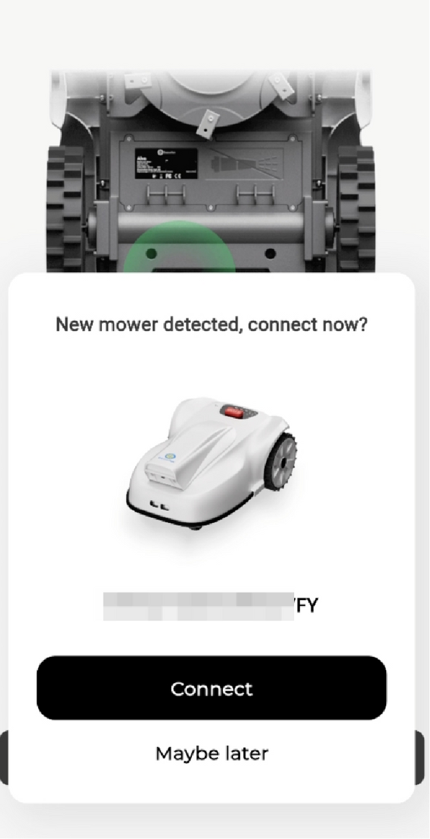
1
Register with your email
2
Select Alva and connect
3
Turn on Bluetooth and pair the mower
4.1
Pair & Connect

Slide 11
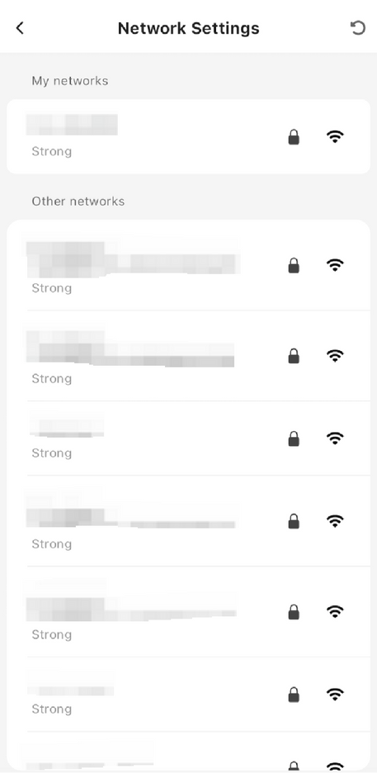
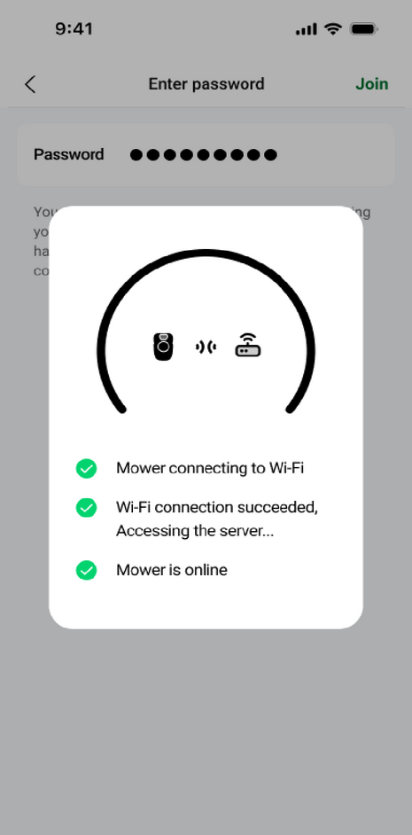
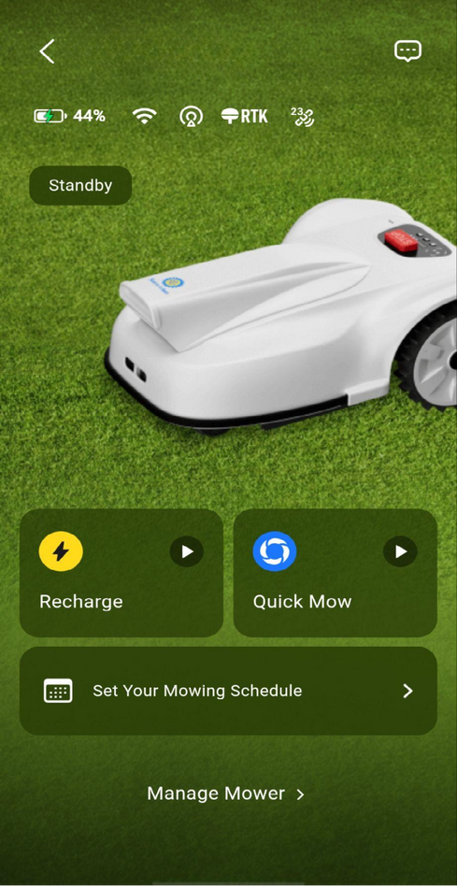
4.2
Connecting Mower to WiFi
1
Select your network
2
Enter the password
3
Mower connected
Sveaverken Alva

Slide 12
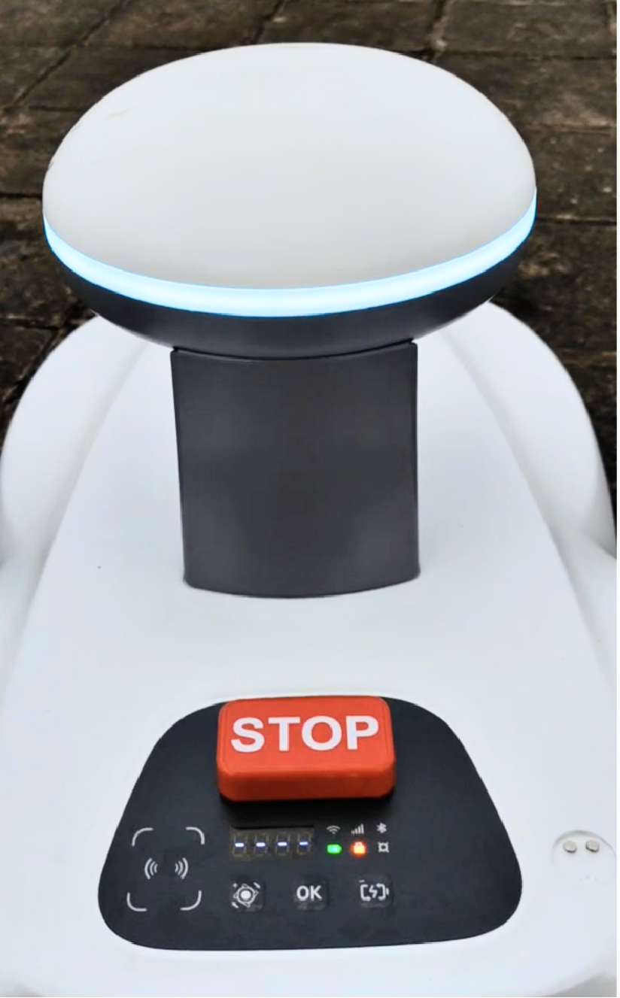
4.3
Bluetooth and Wi-Fi Indicators
Bluetooth: Light up when connected.
Wi-Fi: Blinks while connecting, solid when ready

Slide 13
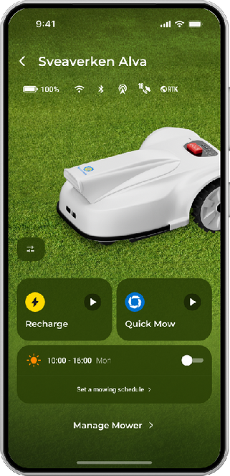

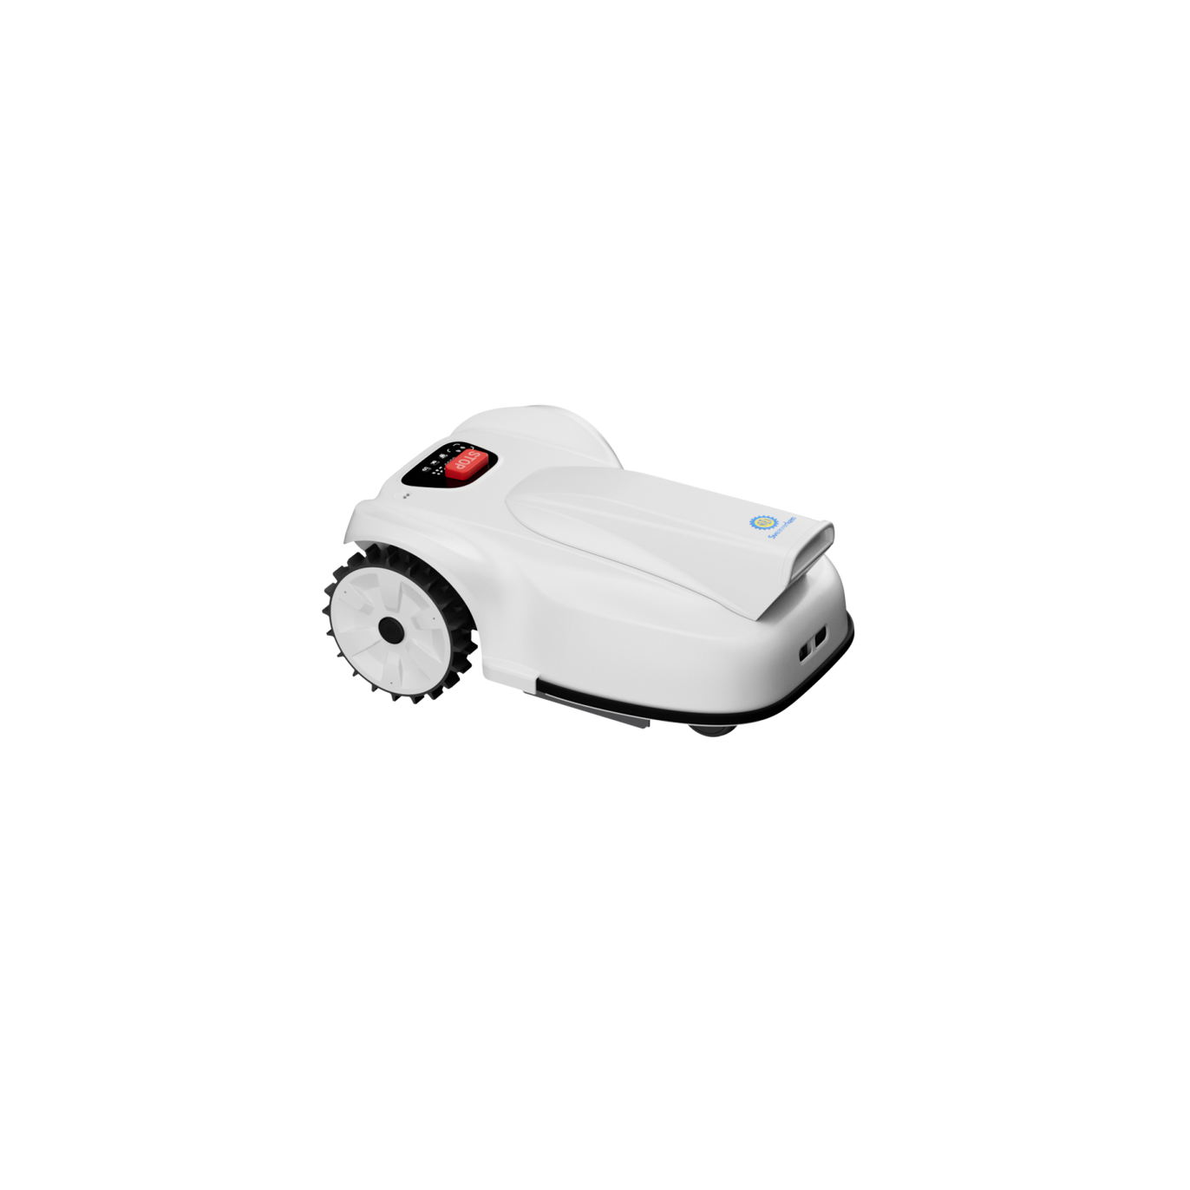
4.4.1
Connectivity Overview
1
Use the app to connect the mower to your network.
The mower connects to the cloud server.
Once confirmed, the mower is online.
2
3
Cloud

Slide 14
4.4.2
Cloud Data Storage
What Data are transmitted and stored on the cloud server?
1
Virtual zone boundaries (no geographic location data)
Mowing missions and schedules
User account details (email, password, mower-pairing information)
2
3

Slide 15
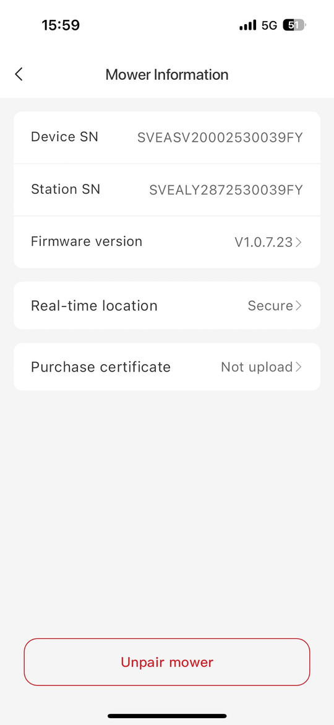
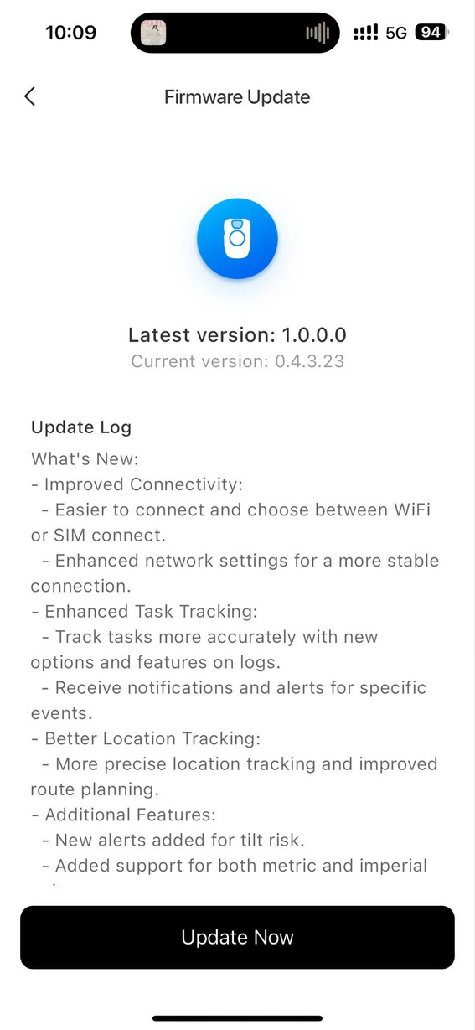
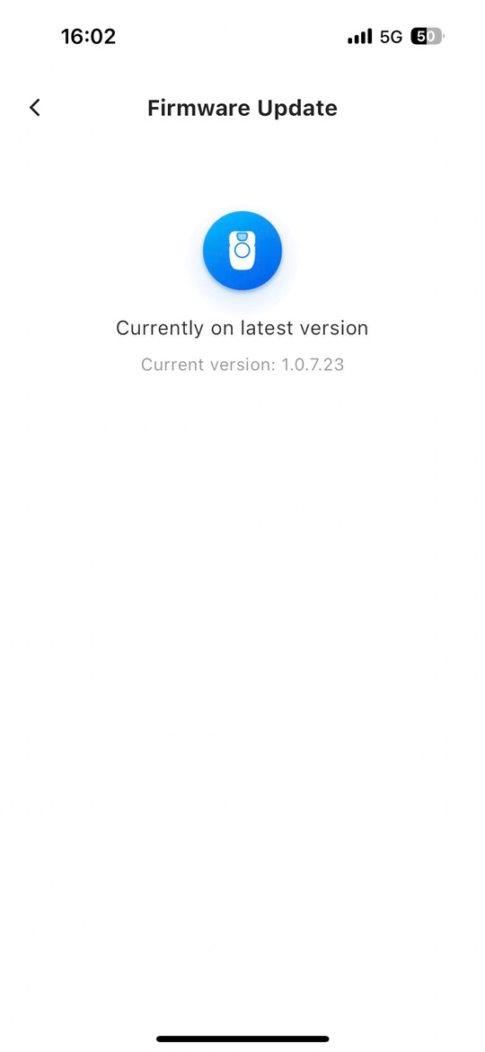
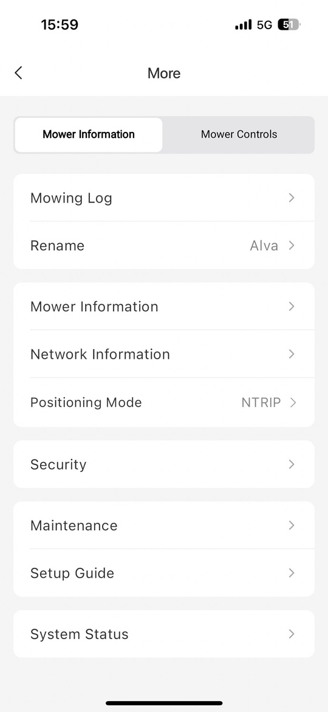
4.5 Firmware Update

Slide 16
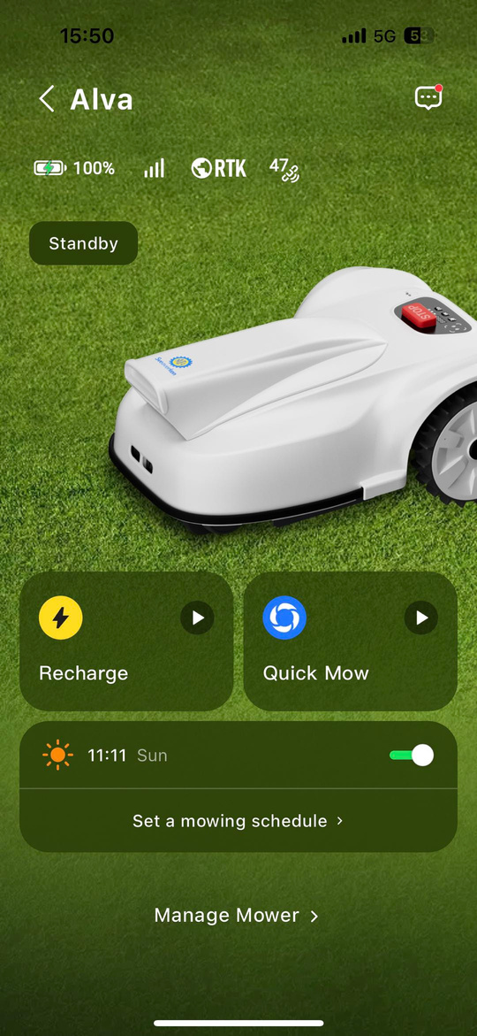
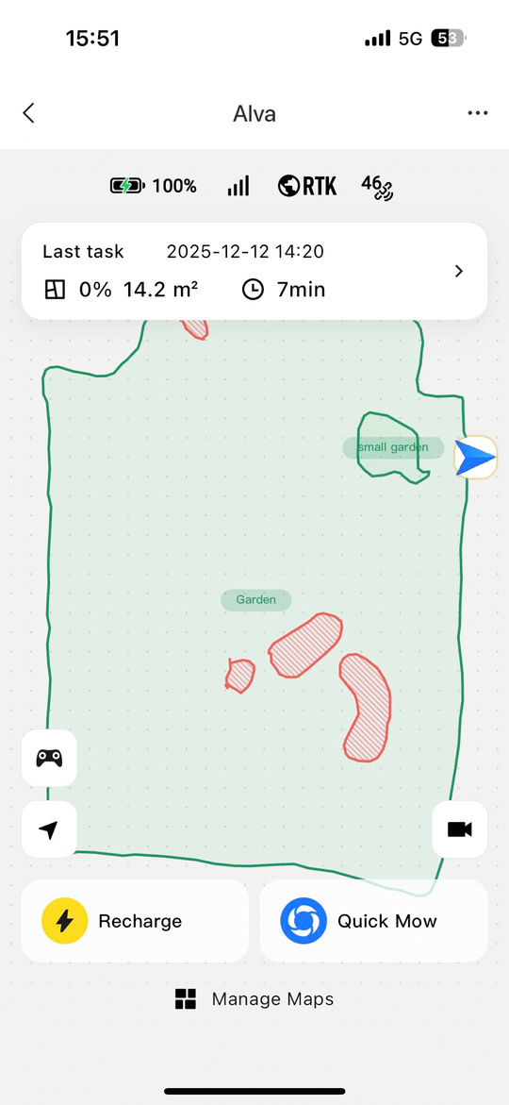
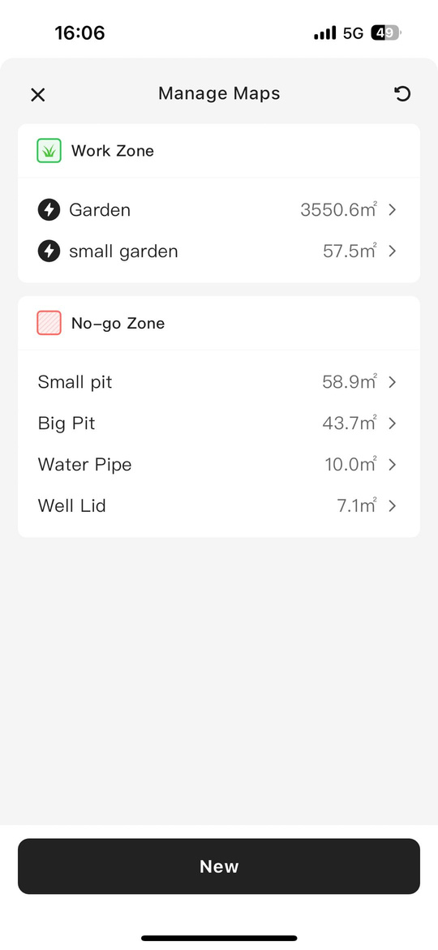
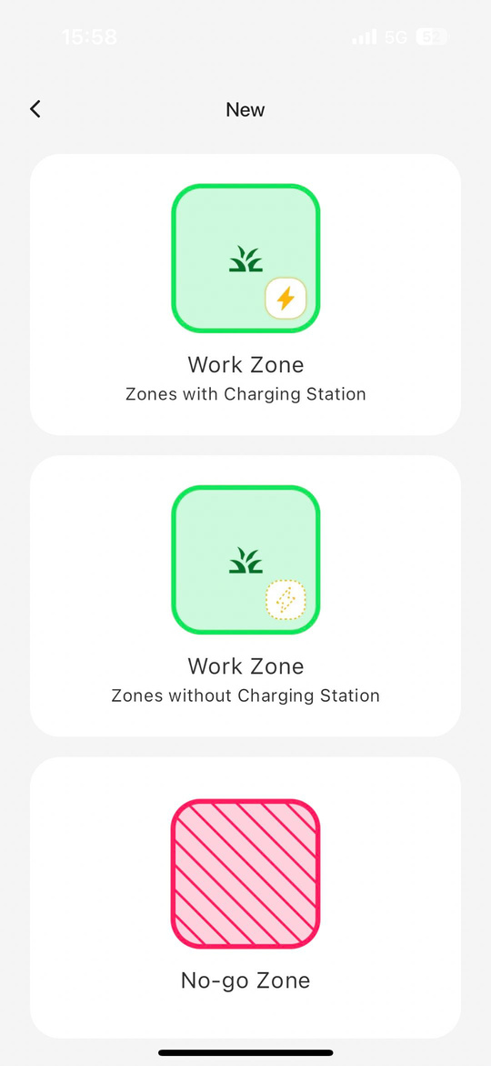
5.
Map Your Yard

Slide 17
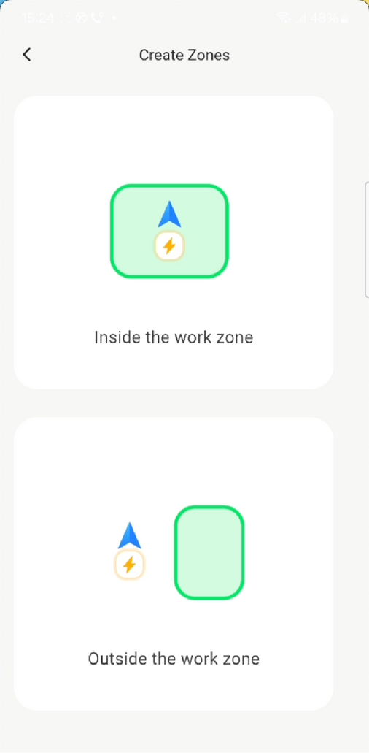
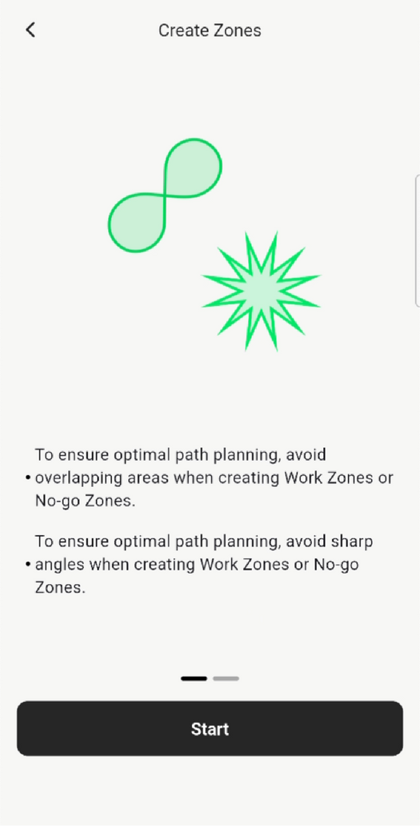
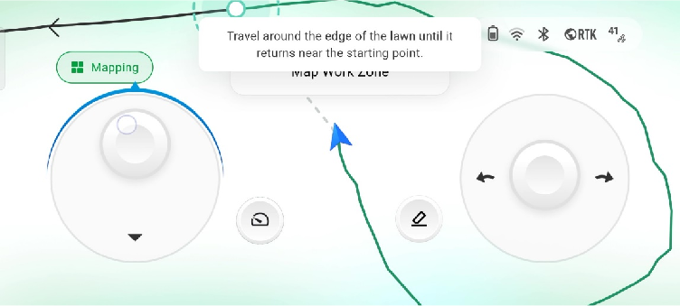
5.
Map Your Yard
Use joysticks to control the mower to drive along the edge of the mowing area to create an individual work zone.
Change the mower speed based on your needs.
Erase the path if an error occurs.

Slide 18
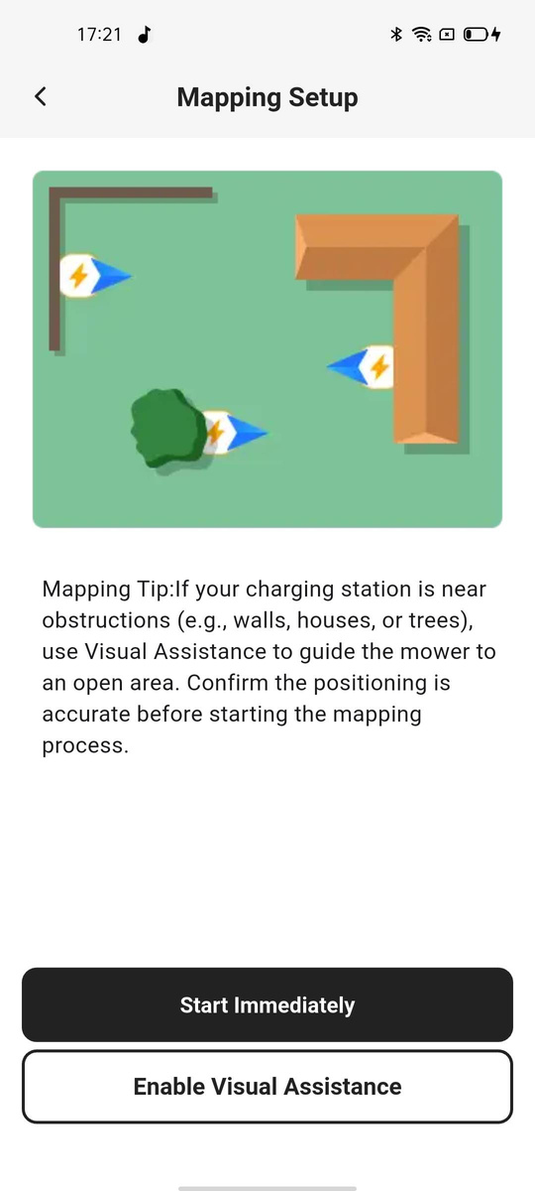
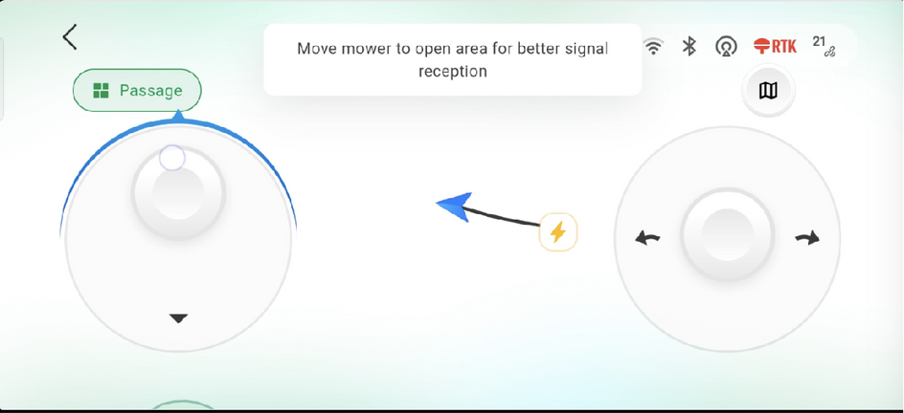
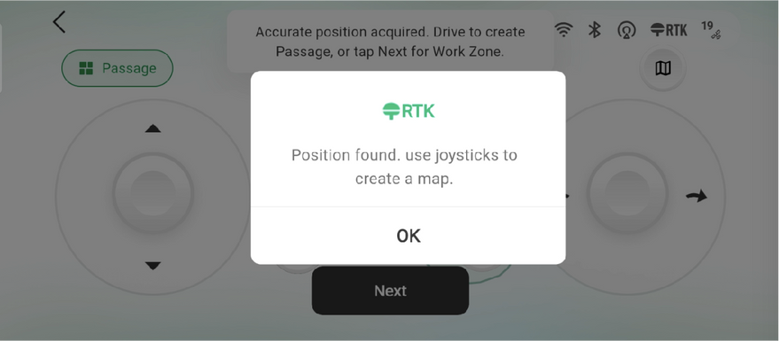
5.1
1
Select Enable Visual Assistance
2
Visual assistance active. Drive the mower to an open area for a stronger signal.
Mapping with Visual Assistance
3
RTK signal restored.
Switch back to RTK positioning.
When the RTK signal is weak, visual navigation keeps your mower mapping accurately.

Slide 19
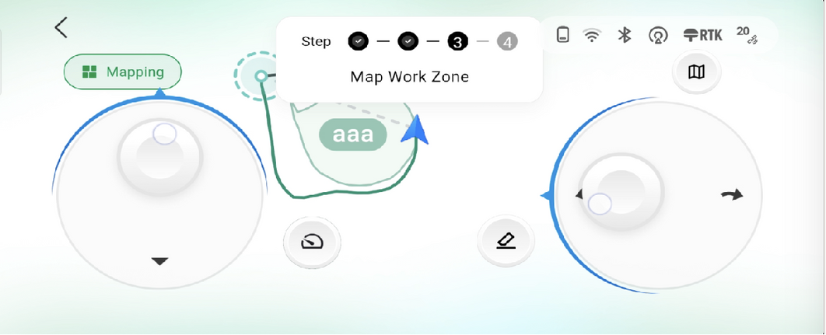
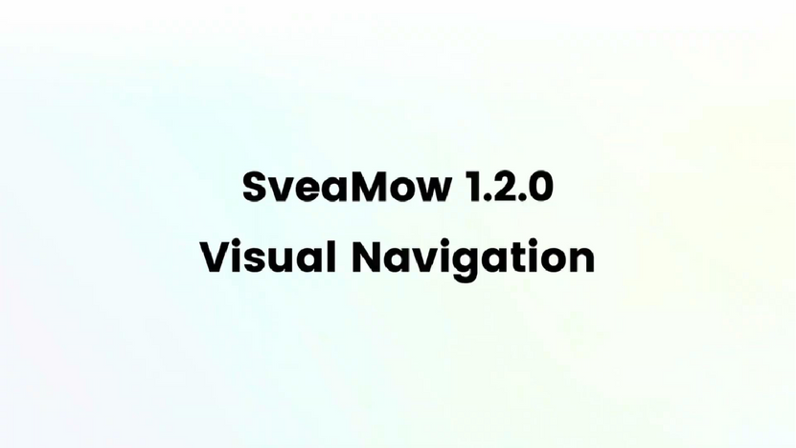
5.1
Mapping with Visual Guidance
4
Map as usual.
5
Video Tutorial

Slide 20
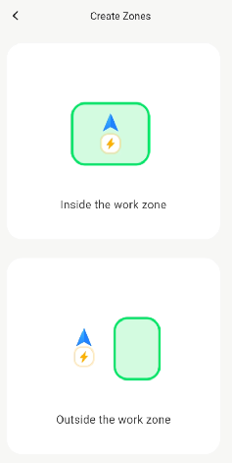
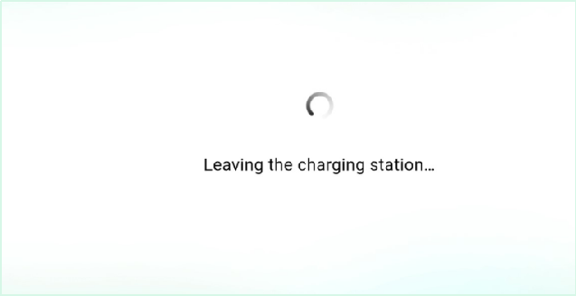
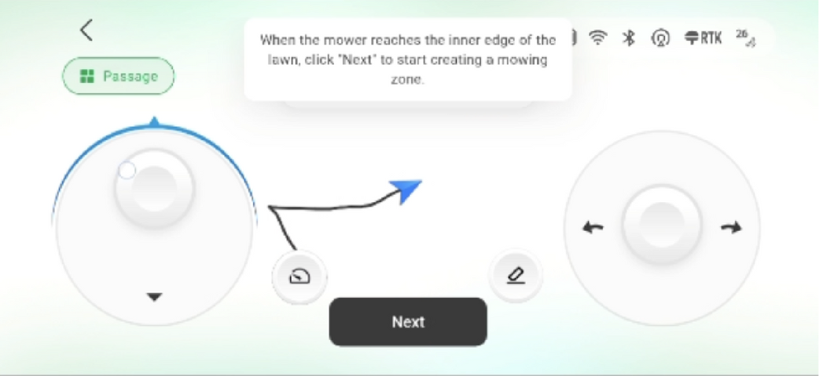
1
Select “outside the work zone”
2
Drive the mower away from the charging station.
3
Guide the mower to the edge of the work area, then tap Next.
*This process creates a virtual path so the mower can find its way back to the charging station..
5.2
Charging Station Outside Work Zone
  Use this mode when the charging station is installed outside the mowing area.

Slide 21
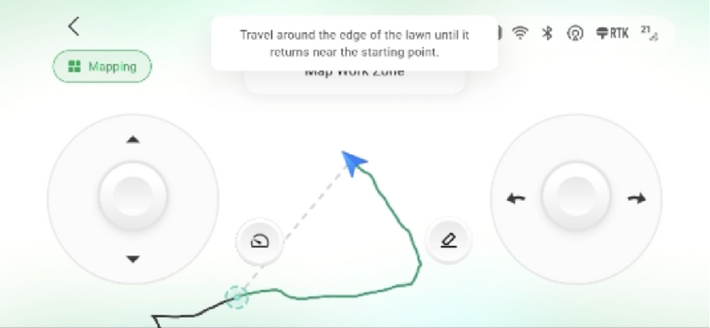
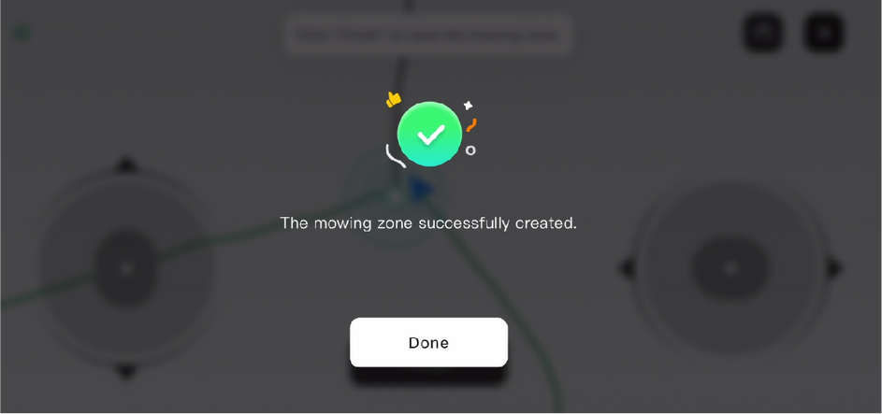
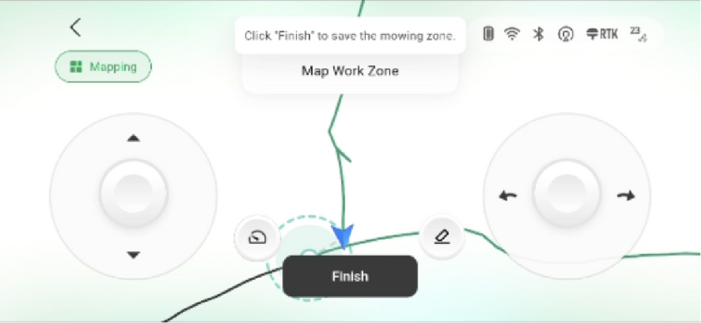
4
Drive along the edge of the work zone
6
Name and save the work zone
5
Return to the starting point to complete the loop.
5.2
Charging Station Outside Work Zone

Slide 22
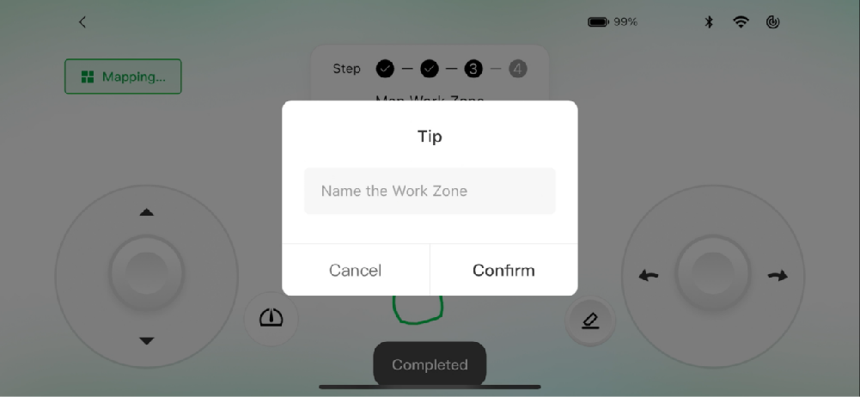
5.3
Charging Station Inside Work Zone
  Use this mode when the charging station is inside the mowing area and no separate path is needed.
1
Select “inside the work zone”
2
Drive the mower around the boundary of the area, then tap Finish, name the zone, and save it.
*The solid line shows the boundary you’ve mapped. The dotted line guides the mower back to the starting point.

Slide 23
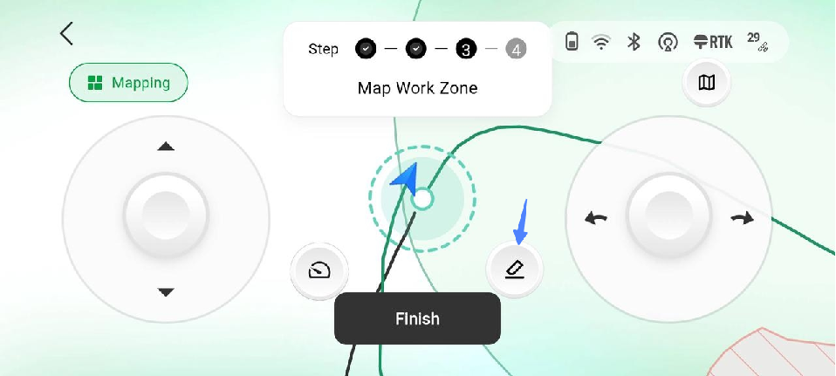
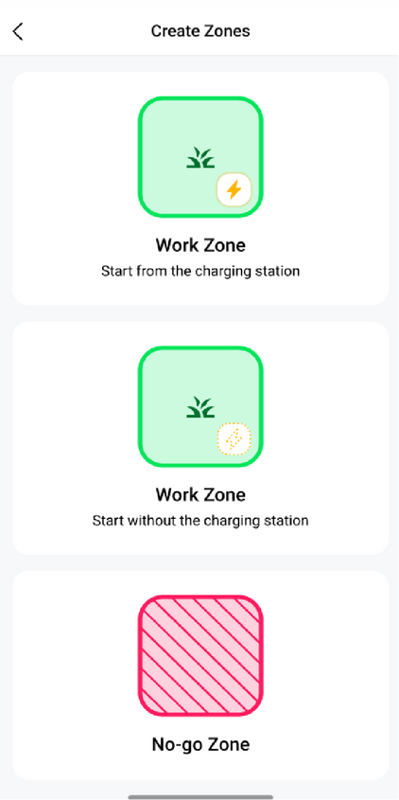
5.4
Mowing Zone Without a Charging Station
  Use this mode for separate lawn areas that don’t have a charging station. Simply carry the mower to the area, create a work zone, and start mowing.
1
Select “Work zone without the charging station” to start.
2
Map the work zone.
* For best mowing performance, start with at least 80% battery. If the battery gets too low, the mower won’t be able to drive back to the charging station and will need to be carried to a zone with a charging station.

Slide 24
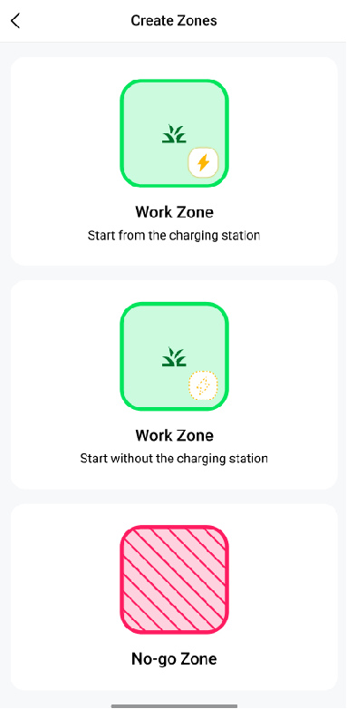

5.5
Create No-Go Zone
Use No-go Zones to protect trees, flowerbeds, ponds, or any area you don’t want the mower to enter.
1
Select “No-go Zone” to start.
2
Drive the mower once around the no-go zone back to the starting point to close the loop.

Slide 25


5.5
Create No-Go Zone
3
Tap “Done” to save.

Slide 26


5.6
See All Zones
Sveaverken Alva
Sveaverken Alva

Slide 27




6.1
Schedule Mowing Missions
Automated mowing for your selected work zones.
Sveaverken Alva

Slide 28



6.2
Quick Mow
Instant mowing for one or more zones.
1
Tap “Manage Mower” and select the work zones in the order you want them mowed.
2
Tap “Quick Mow” to start the quick mowing mission.
Sveaverken Alva

Slide 29


6.3
Pause and End Mission
1
2
Tap “Recharge” to send the mower back to the charging station.
3
If the mower can’t return by itself, tap the controller icon to manually drive it back.
Tap “Pause” to temporarily stop the mission.
Press and hold “Stop” to end the mission.

Slide 30



Mowing Logs and Notifications
Sveaverken Alva

Slide 31





Settings
Fine-tune mowing behavior and safety features for your lawn.
Resume Mowing
Obstacle Sensing
Rollover Protection
Non-Slip Settings

Slide 32

FAQs

Slide 33


Understanding RTK Technology
What is RTK?
    RTK stands for Real-Time Kinematic. It's a technique that significantly improves the accuracy of positioning data obtained from satellite-based positioning systems like GPS.
Why is RTK important?
Accuracy: RTK can provide centimeter-level accuracy, compared to the meter-level accuracy of standard GPS. This is crucial for applications where precision matters, such as:
    Surveying and Mapping: Creating highly accurate maps and digital terrain models.
    Construction: Ensuring precise positioning of equipment and materials.
    Agriculture: Optimizing crop yields through accurate field mapping and equipment guidance.
    Drones: Achieving stable flight and accurate data capture for aerial photography and videography.
Notes:
29

Slide 34


How Does RTK Work?
RTK uses two receivers:
Base
    Base Station: This receiver remains stationary at a known location. It continuously tracks the satellite signals and calculates corrections for errors in the signals. You can set up your own base station at your property, or you can connect/subscribe to a NTRIP service that transmit the signal via Internet.
    Rover: This receiver is the one you move around (like on a drone or surveying equipment, in this case, in Alva). It receives the same satellite signals as the base station and also receives the corrections from the base station in real-time.
Rover

Slide 35

Ideal lawn Conditions for Testing
Wi-Fi Coverage
Ensure full Wi-Fi coverage across your yard so the mower can send real-time location updates during mowing missions.
Size
Ideal lawn size is 1,000–2,000 m². On a flat, regular lawn, Alva can cover up to 2,000 m² in 24 hours – and is ready for tougher tests.
Multiple zones
i.e. front and back yards connected by a pathway, multiple sections of lawn divided by a driveway. This helps test the robot’s ability to navigate autonomously and complete mowing missions independently.

Slide 36
Ideal lawn Conditions for Testing
A slope somewhere on your lawn, no steeper than 35°/70%.
Alva is designed for around 33° / 65% inclines, so this helps push its performance to the limit.
Objects on your lawn, pets that might roam free.
e.g. trampolines, playhouses, swing sets, kiddie pools, raised flower beds etc. on top of your lawn. This will test the robot’s ability to navigate around these objects and continue mowing.

Slide 37
Caution
  Keep the power adaptor of the charging station away from the rain or moisture - put a cover on top if it is outside, or more ideally, keep it indoors and use a weather-proof power extension cord to connect to the charging station.
  We recommend cleaning the mower after every week or so to avoid having mud stuck in the teeth of the wheels. A spray with some pressurized water from a garden hose will do.

Slide 38

Recommendations
  It is not recommended to mow in the rain. The rain sensor will pause quick mow missions or skip scheduled missions unless you override it in the app.
  Set up the Wi-Fi router near the lawn mower to avoid obstructions such as walls and ensure good network connectivity.
  The passage from the charging station to the work zones must be kept clear; do not accumulate debris that may affect the lawn mower's movement.

Slide 39

Recommendations
Mowing Height Tips
  The mower isn’t designed for very tall, overgrown grass. If needed, use a two-pass approach (built-in instructions in the app and coming soon): first mow at the highest cutting height, then mow again lower after the lawn has recovered.
  We recommend mowing off no more than ⅓ of the grass’ height each time.
    Mowing too short or scalping results in stress to the grass plant. Weak grass plants will take longer to recover.
    Mowing too short can allow weed seeds to get more sun and increase the chance of germination.
This grass may be too long to mow. Cut to about 50 mm first, then mow shorter.

Slide 40
Operating Environment & Temperature
Beat the heat
  Place the charging station in a shaded spot and avoid long, direct sunlight.
  Schedule mowing for the cooler hours of the day and only mow when the grass is dry to prevent clogging.
Storage tips
  When the mower is not in use, brush off grass and dirt and wipe it clean. Do not use high-pressure water, as it may damage the mower.
  Store both the mower and the charging station indoors.

Slide 41
Software/App
What permissions are needed?
  Location, bluetooth, storage
What connectivity is required?
    Bluetooth – turns your phone into a remote controller for the mower.
    Wi-Fi – used for scheduling and syncing mowing tasks.
Will any of my data be accessible by Sveaverken?
  Some system logs are sent to Sveaverken to improve performance and provide support.
  Data uploaded to the cloud may include:
    The shape and size of your lawn
    Mower activity status (mowing, standby, moving, etc.)
Data we do not access:
    The exact GPS coordinates of your lawn/yard
    Any images or videos of your yard

