Slide 1


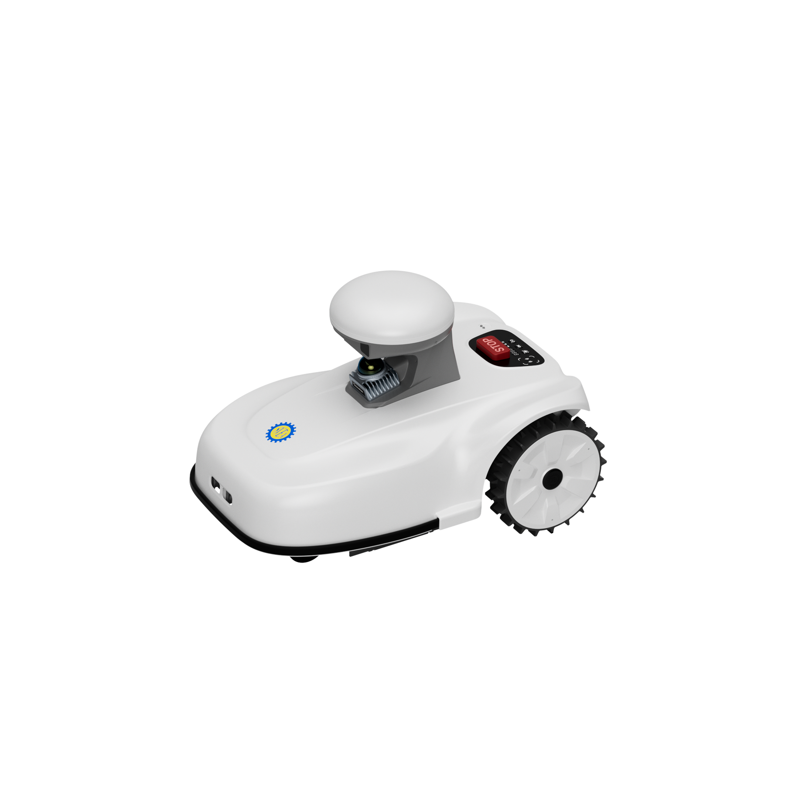

Testing Guide
Sveaverken Blix
Robotic Lawn Mower
https://www.sveaverken.com/products/sveaverken-Blix
Copyright © Sveaverken Rights Reserved.
1
Notes:
Hello everyone. Today I’m excited to introduce you to the Sveaverken Blix, our advanced robotic lawn mower designed for precise, intelligent turf care. This guide will walk you through everything from unboxing to your first mow.

Slide 2
Summary
Easy Presentation to Blix
Preparation & Setup
Operations in the APP
2

Slide 3
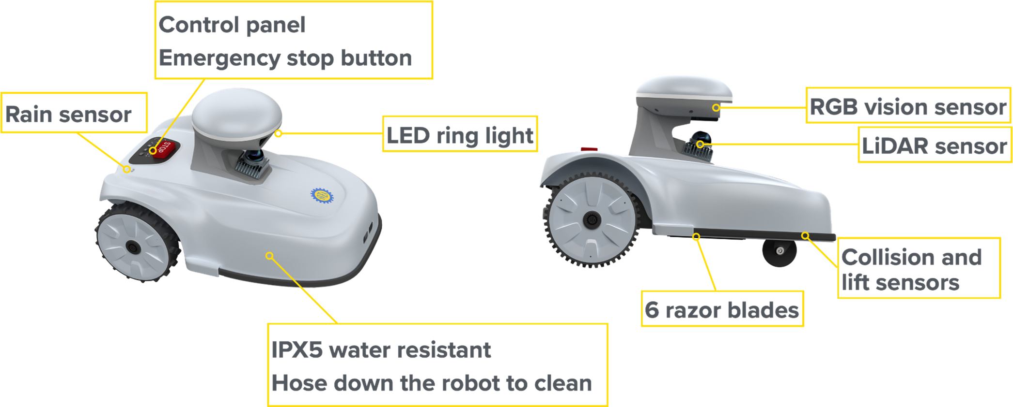
Meet Blix
Control Panel and Emergency Stop
Rain Sensor
Vision Sensor
LED Ring Light
3D LiDAR
Collision and lift sensors
Blades
IPX5 Water Resistent
Hose down the mower to clean
3
Notes:
Let’s look at what makes Blix special. It features 'Full Environmental Awareness' by combining a 3D LiDAR sensor with a Vision Sensor
Tips: Mushroom part

Slide 4

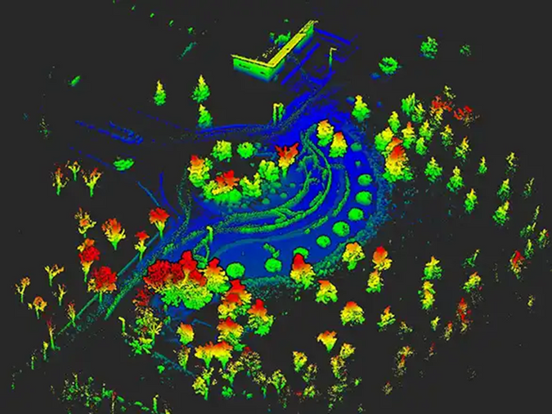
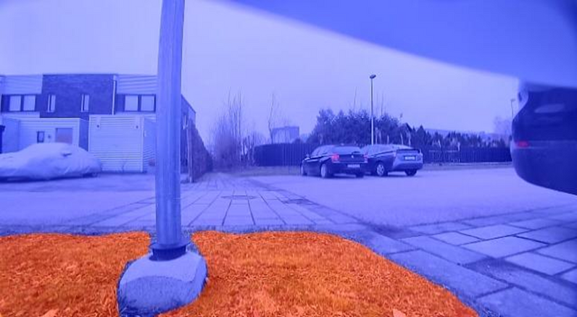
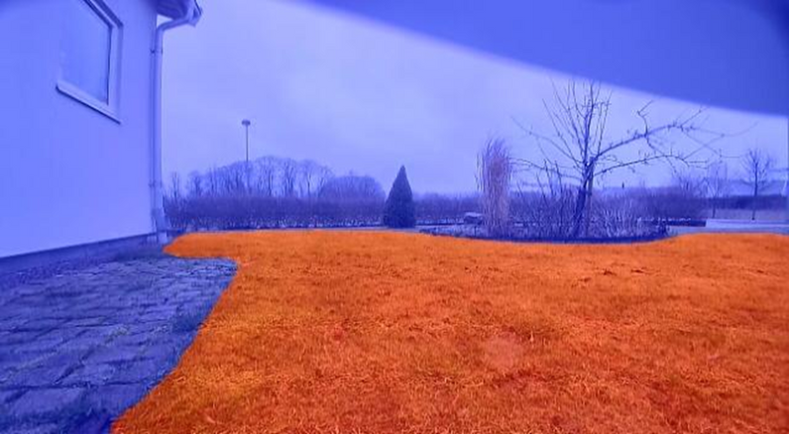
Full Environmental Awareness
3D LiDAR and 3D Point Clouds
Blix creates a 3D point cloud map of your lawn that enables accurate path planning and mowing.
Blix recognizes grass and understands where it should work.
This means it won’t go into sand traps, water hazard, driveways, or other obstructions.
4
Notes:
. It creates a 3D point cloud map of your lawn, meaning it knows exactly where the grass is and avoids driveways or sand traps intelligently. It’s also built to last: it has an IPX5 water-resistance rating, so you can simply hose it down to clean it.

Slide 5
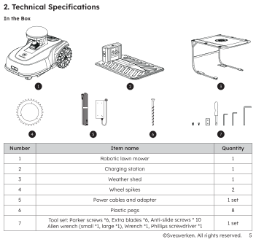
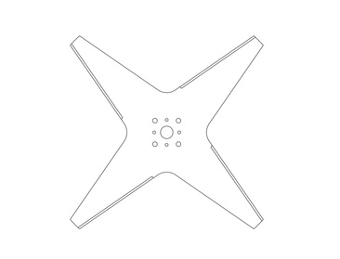
In the Box
As soon as you receive the box, please contact FAE for recorded unboxing and installation guidance
Blix Robotic Lawn Mower
Charging Station
Weather shed
Wheel spikes *2
Power cables and adapter
Plastic pegs *6
Cross-shaped
blade
Tool set
Screws for skid plates *6, Anti-slip screws * 10, Allen wrench (small *1, large *1), Extra cutting blades *6, Phillips screwdriver *1, Wrench *1
5
Notes:
Inside the box, you have the Blix mower, the charging station, and a Weather Shed to protect the station. We also include all necessary tools, ground pegs, Wheel spikes（avoid Slipping) and a set of spare cutting blades. As soon as you get the box, please contact our team for the unboxing guide.

Slide 6


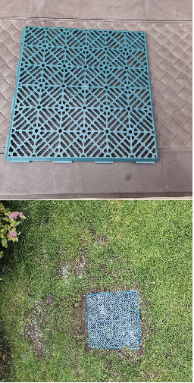
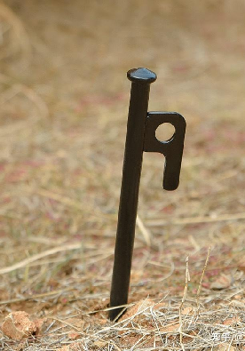

Lawn Check
Safety First
Walk around your lawn to check for any objects on the lawn:
Clear the mowing area of rocks, large twigs, tree branches, or anything that might block the mower during a task.
Low-lying rocks and hard objects in the lawn should be cleaned up in advance to prevent damage to the mower blades.
Address muddy spots or holes by reseeding, covering with a plastic turf tile, or placing anti-slip mats to improve traction and avoid mower jams.
Keep pets and children away from the lawn when the mower is working.
6
Notes:
Before we start, safety is priority number one. Please walk around your lawn and clear away rocks, large branches, or anything that could damage the blades. Also, ensure pets and children are kept away from the area while the mower is working.

Slide 7
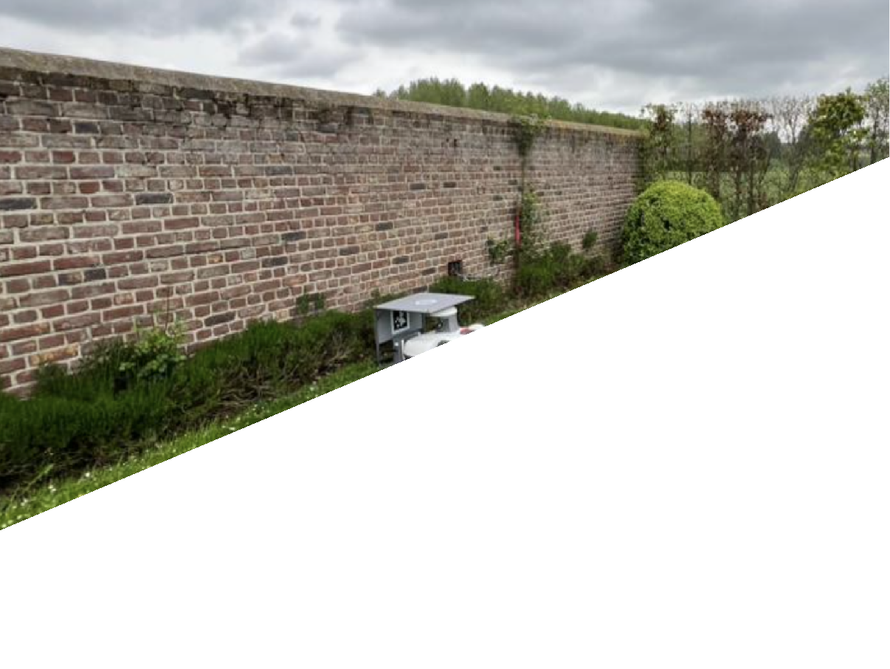
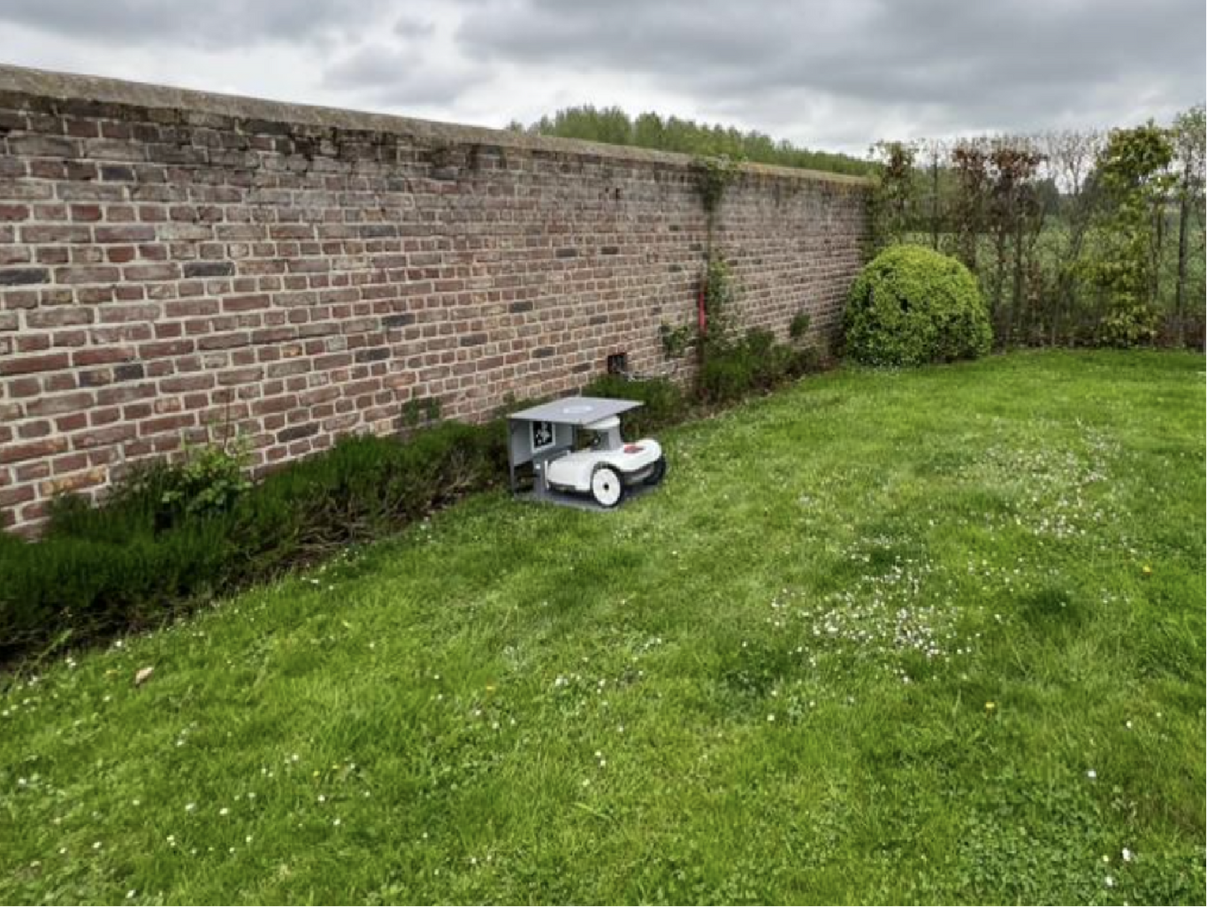
1.
Setup
Charging station and weather shed
Place the station and shed
  Place the charging station and weather shed together on flat, stable ground
  Choose a shaded area for optimal performance
  Keep a 2 m (6.5 ft) radius around the station clear of obstacles so the mower can start and return smoothly
2 m or 6 ½ ft
Secure the setup
  Secure both the charging station and weather shed to the ground with pegs so the mower can reliably recognize and dock at the station
Connect power safely
  The power adapter is for indoor use only. If used outdoors, keep it in a dry, waterproof enclosure.
  Use a weather-resistant outdoor extension cord to connect the station to an indoor power outlet
Weather protection
  IPX5: Blix can withstand rain and dirt during normal operation
7
Notes:
Now, let's set up the home base. Place the Charging Station and Weather Shed together on flat, stable ground. Crucially, keep a 2-meter (6.5 ft) radius clear around the station so Blix can dock smoothly. Secure everything to the ground using the included pegs.

Slide 8

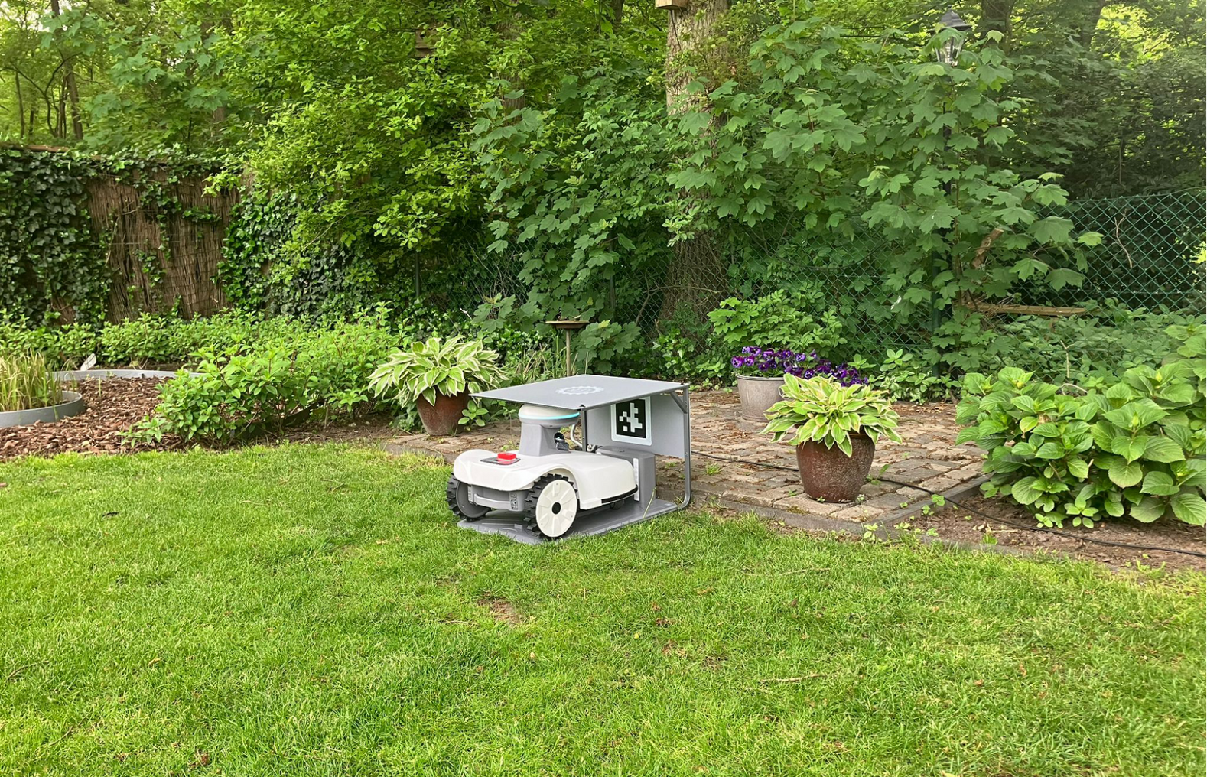
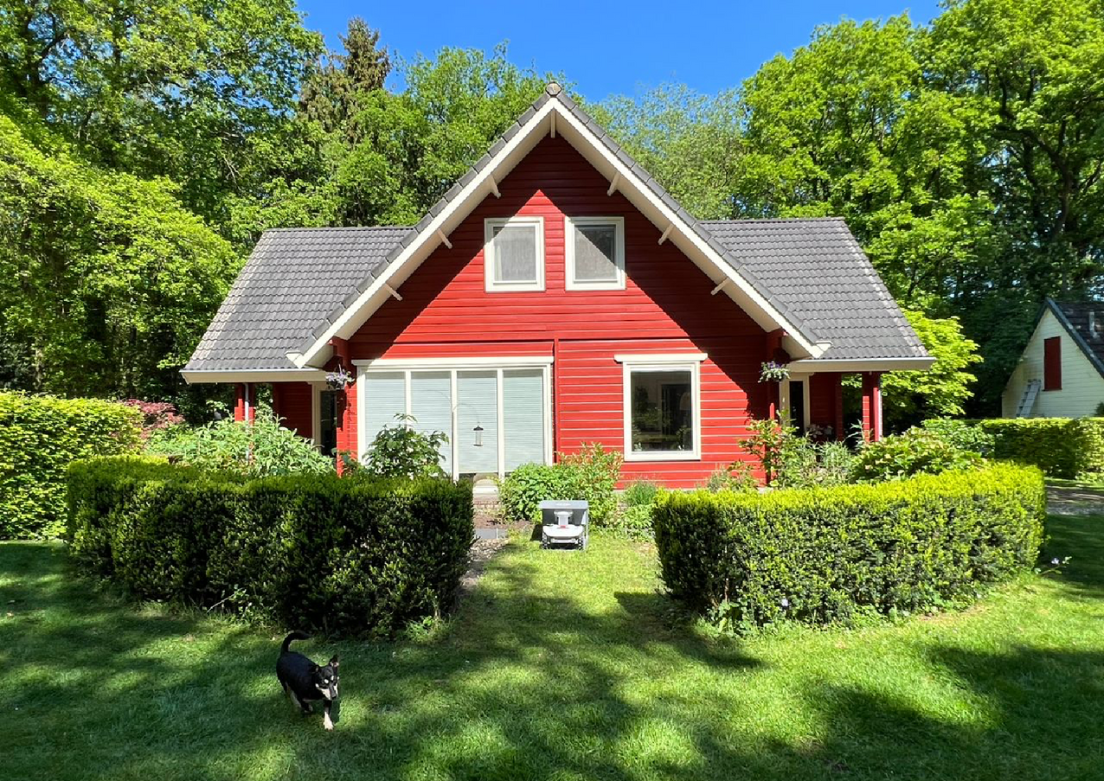
Good Position
OK Good clearance on a flat surface
OK Grass-only operating area
8

Slide 9

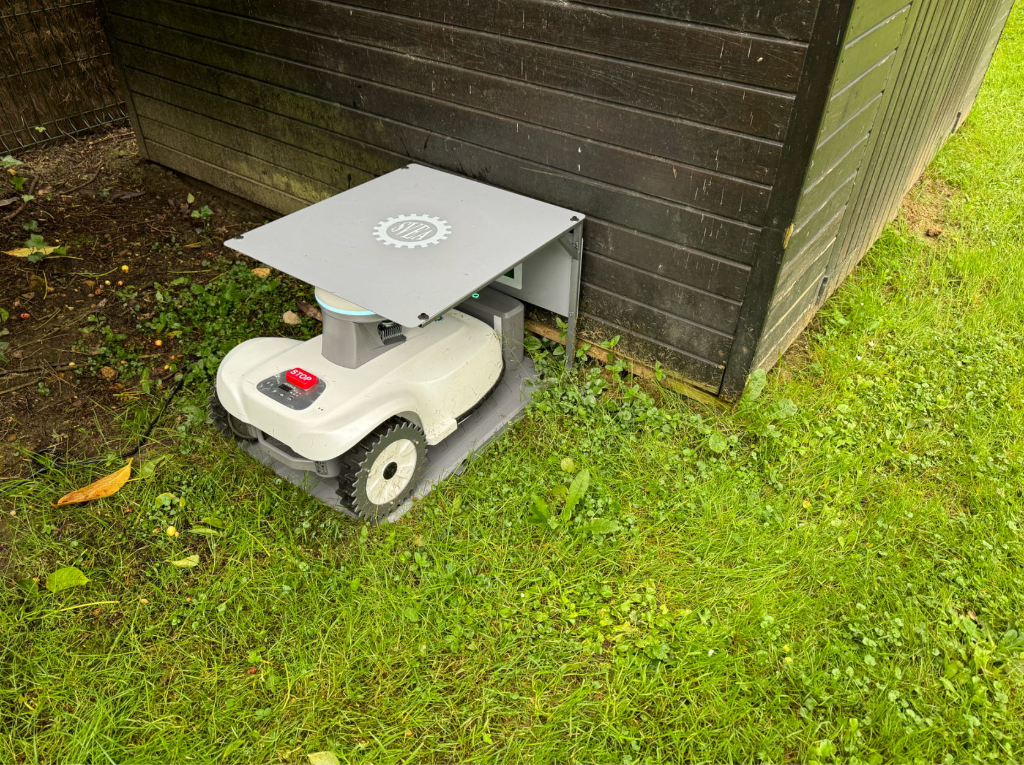
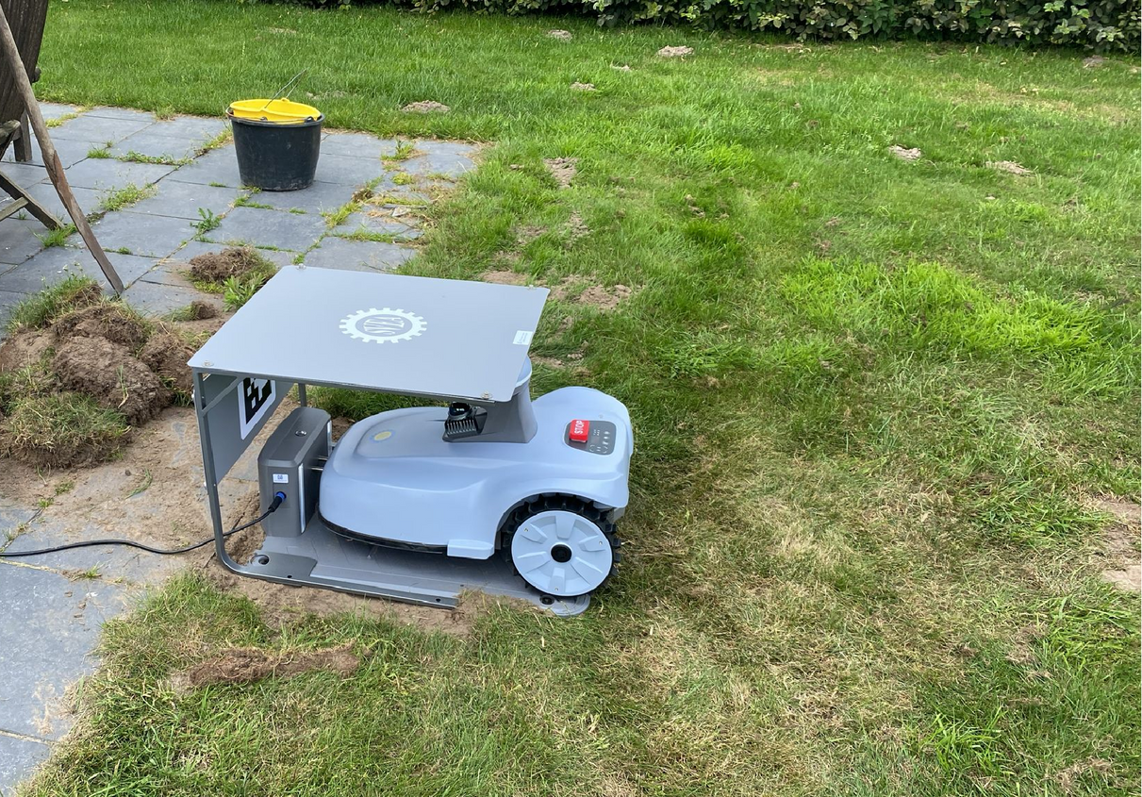
Good Position
OK Can be placed against a wall
OK Trim/remove grass to level the surface
9

Slide 10

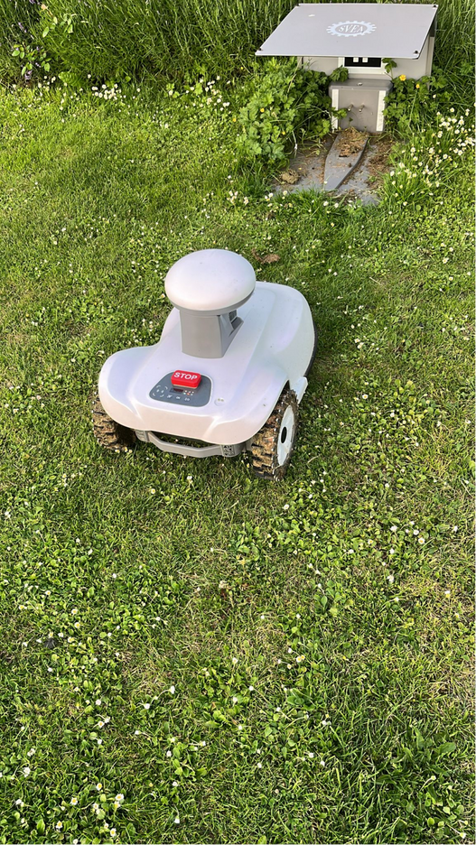
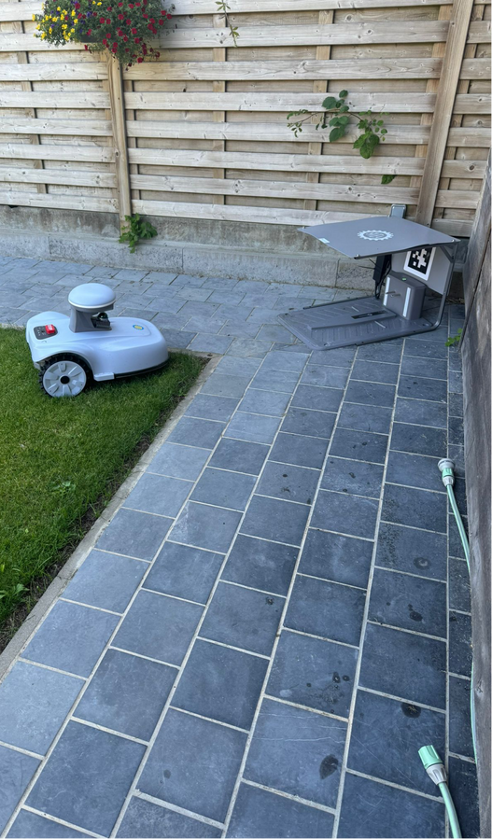
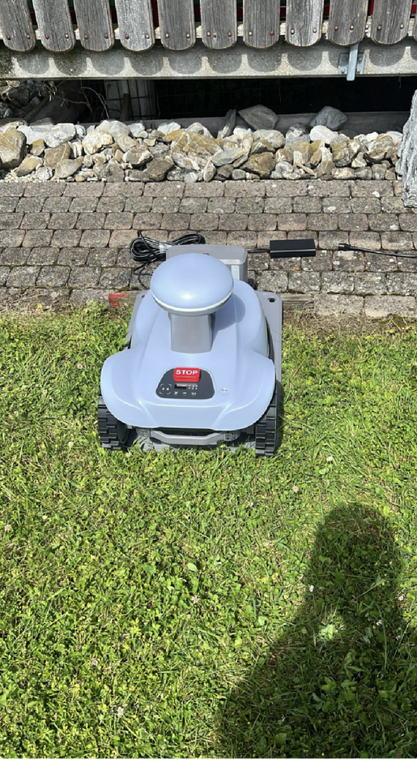
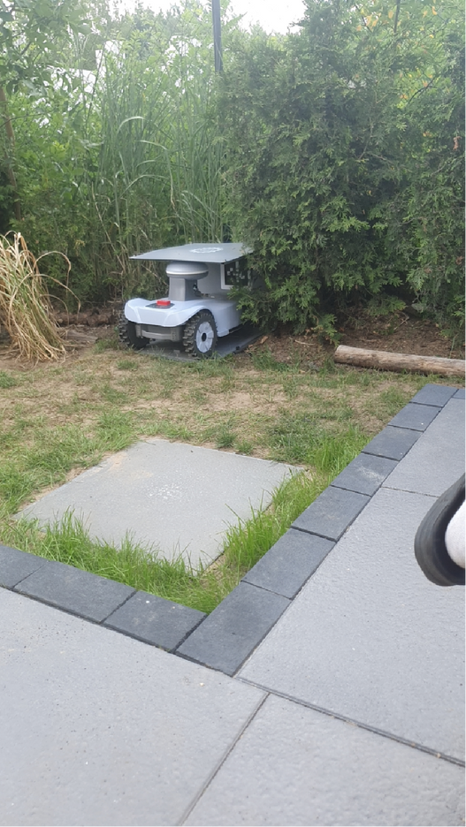
Bad Position
Good position with proper clearance, but weather shed is missing.
Adapter should not be left outdoors.
Overgrown vegetation around the charging station may obstruct docking or interfere with operation as it grows.
Overgrown grass can confuse the mower.
Trim grass regularly or carve out a space.
Lay plastic turf tile or anti-slip mats to prevent growth.
Placing it in the corner interferes with the current algorithms.
It's better to place it directly against the wall/fence.
10

Slide 11
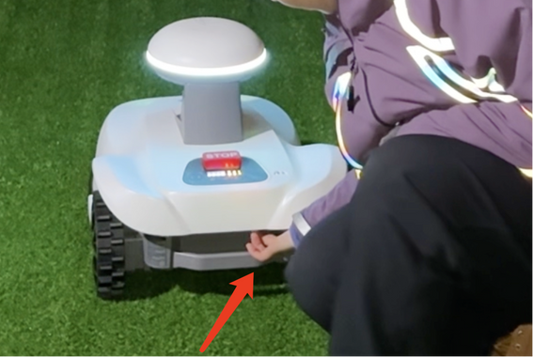
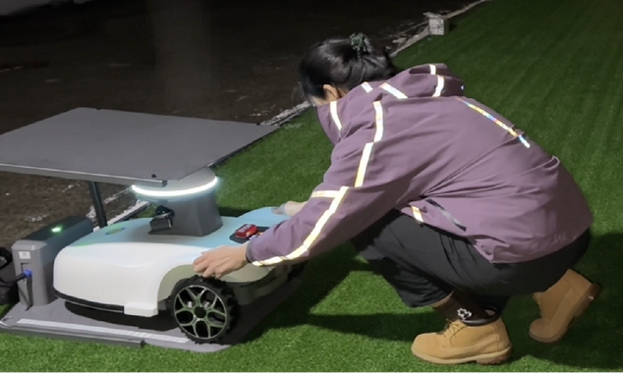
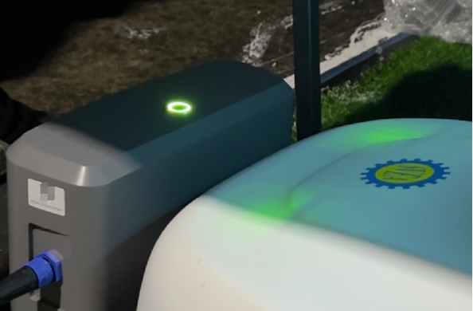
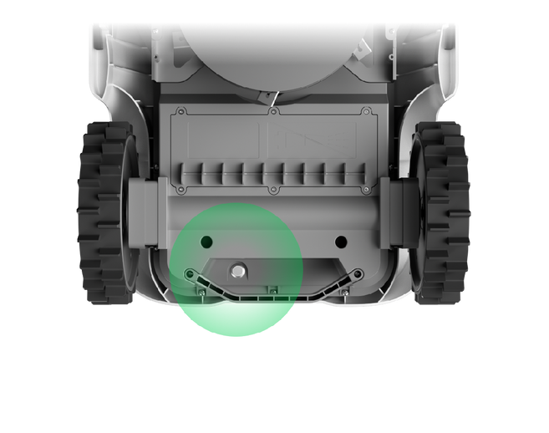
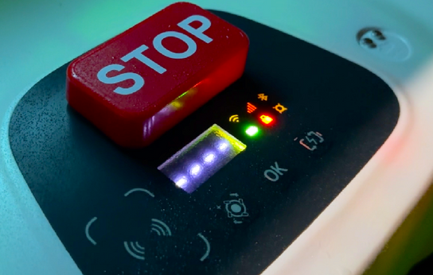
1.1
Charging
1
Find the power button at the bottom of the mower. Press to turn it on.
2
Press the STOP button. Push the mower into the charging station.
3
The battery light on the charging station will blink green. This means the mower is charging.
11
Notes:
Connect the power. Please note the power adapter itself is for indoor use only, so keep it dry. Turn on the mower using the power button at the bottom. Then, push the mower manually into the station to charge. You will see the battery light blink green.

Slide 12
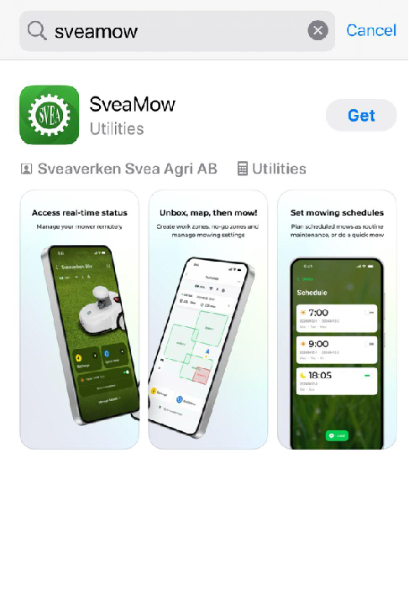
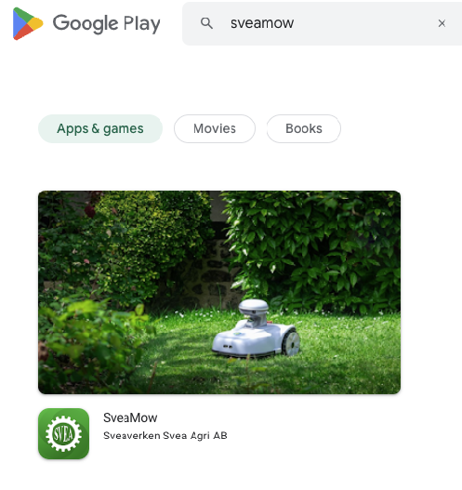



2.
Software
Download the SveaMow App
12
Notes:
Download the SveaMow App and register

Slide 13
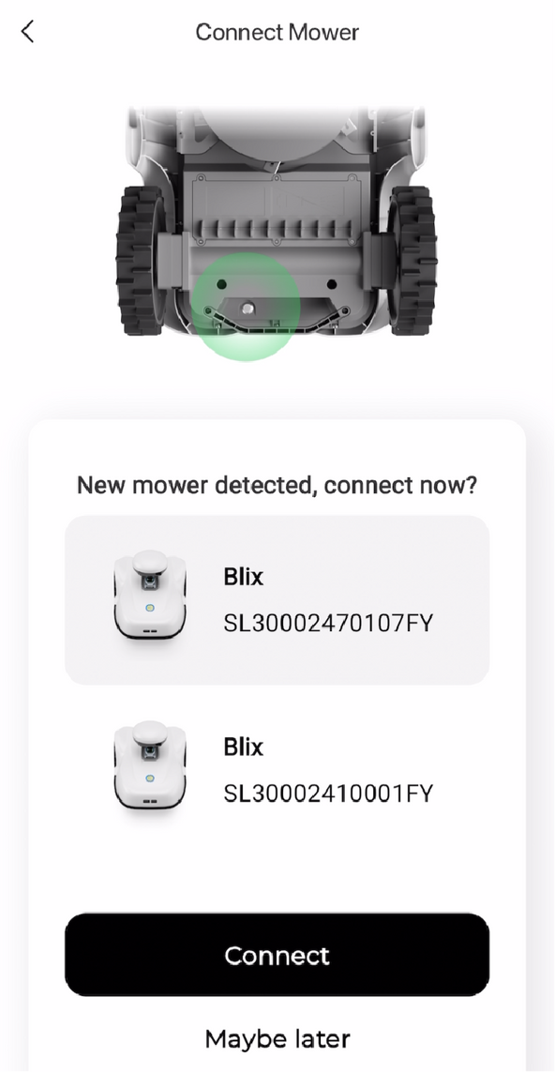
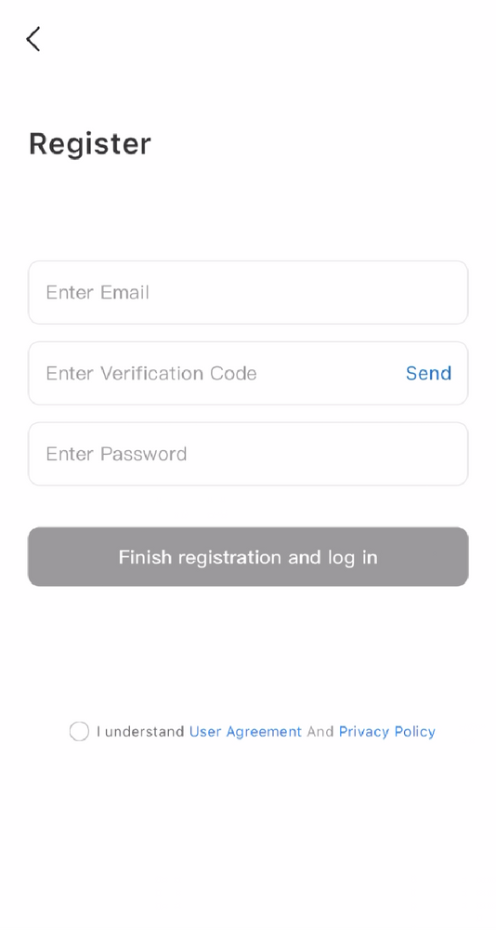
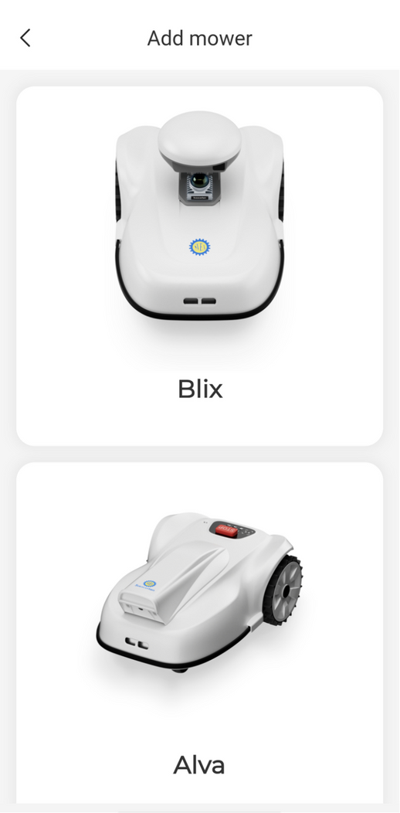
1
Register with your email
2
Select Blix and connect
(Choose Blix HC if you are using the high-cut version.)
3
Turn on Bluetooth and pair the mower
Serial Number
2.
Serial Number
Pair & Connect
13
Notes:
. First, pair with the mower via Bluetooth.

Slide 14
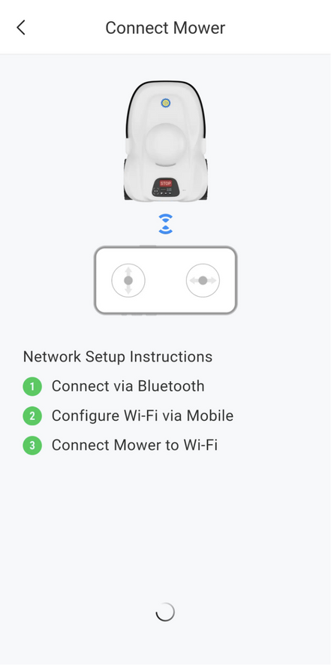
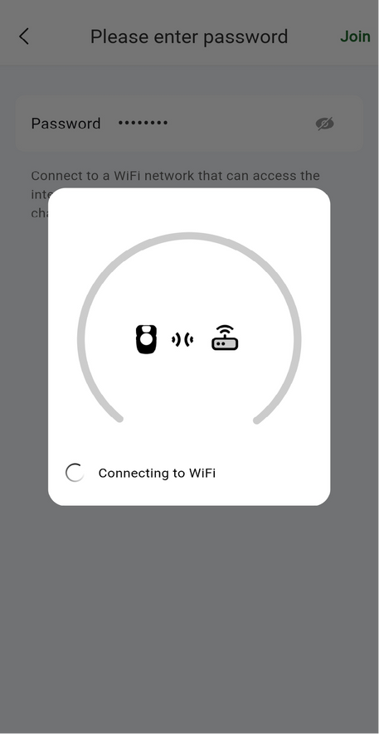
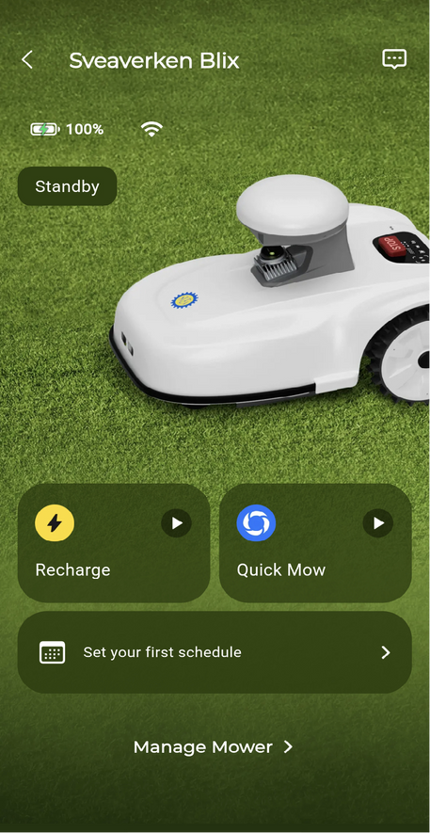
2.1
Connect Mower to Wi-Fi
WiFi requirements
1
Wi-Fi name only supports letter, digits and following characters: . - _ @ # $ % ^ * ()\
2
Wi-Fi password must be at least 8 characters long (or empty for Public Wi-Fi)
3
Wi-Fi cannot be encrypted via WPA3
14
Notes:
Next, connect to Wi-Fi (2.4GHz) for remote control.

Slide 15
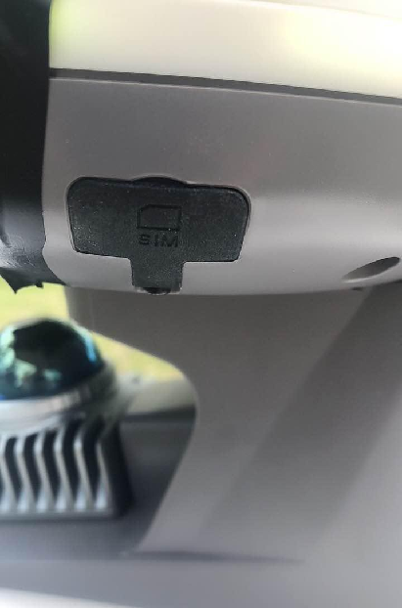
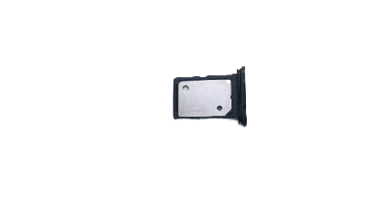
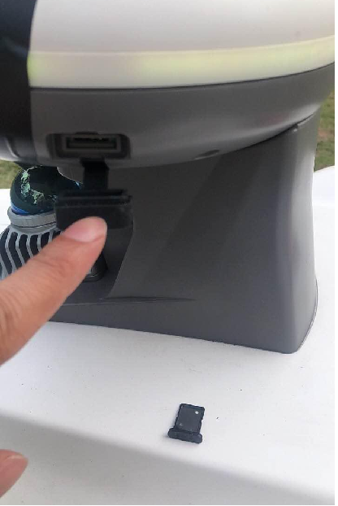
2.2
Connecting via SIM Card
1
Activate the SIM card in a phone
If the SIM card has a PIN code, disable it before inserting it into the mower
The mower must be turned off before inserting the SIM card.
Make sure to insert the SIM card in the correct orientation to avoid damage.
2
3
4
15
Notes:
If you don't have Wi-Fi in the yard, Blix also supports a SIM card. Important: If your SIM has a PIN code, you must disable it on a phone before inserting it into the mower.

Slide 16
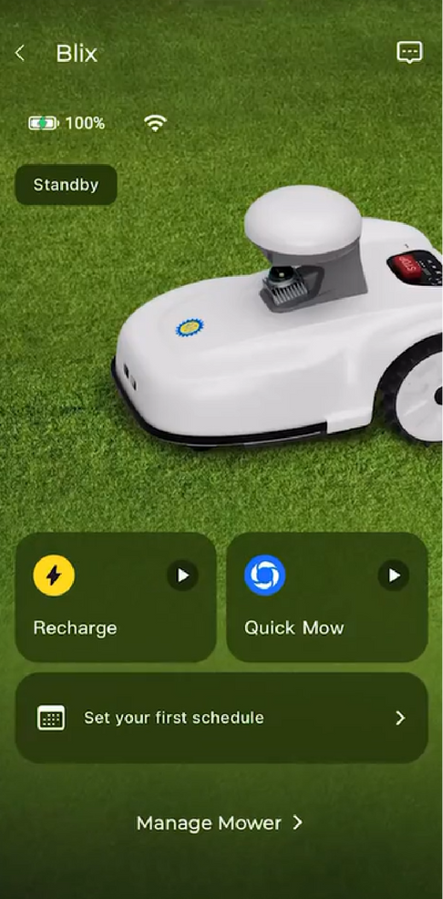
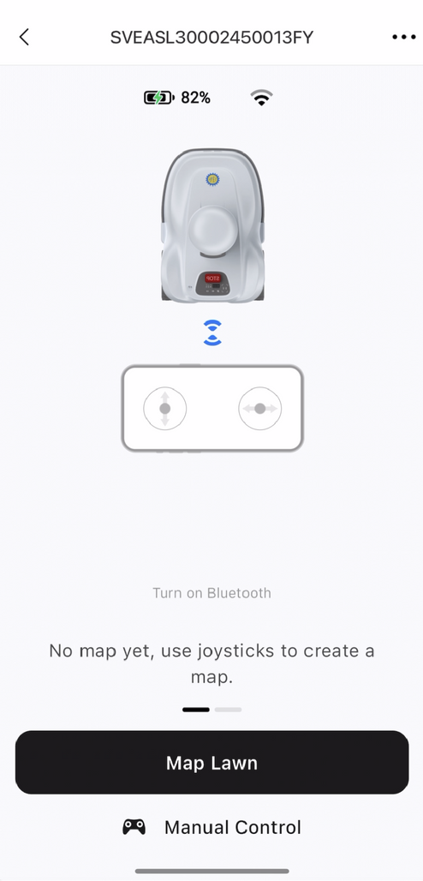
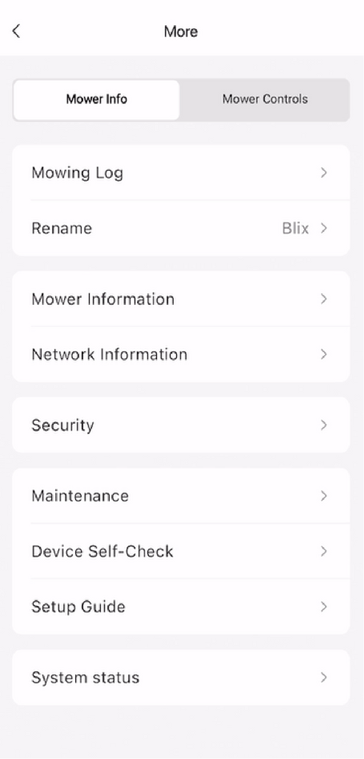
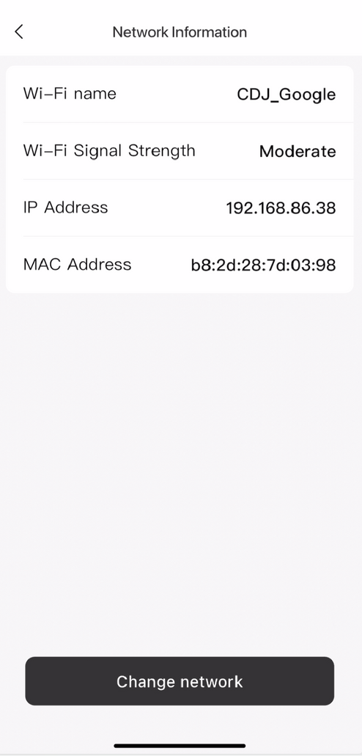
2.3
Mower Connected
Blix
16

Slide 17
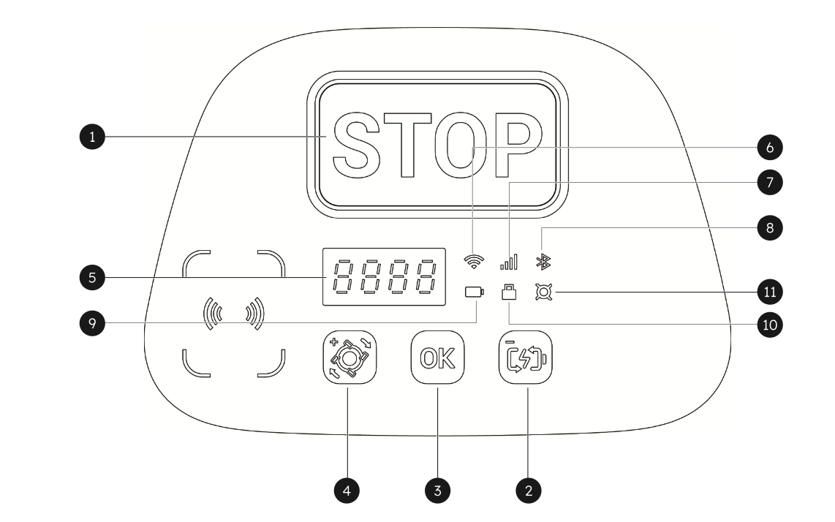
2.3.1
1 | Emergency Stop
2 | Return to Charge
3 | Confirm
4 | Start Mowing
5 | Display Screen
6 | Wi-Fi
7 | Cellular Connection
8 | Bluetooth
9 | Battery Level
10 | Lock
11 | Blades
Indicators
17
Notes:
You can also control Blix directly from the panel. You have a large STOP button for emergencies. There are dedicated buttons to 'Start Mowing' and 'Return to Charge'. The icons on the right show your Wi-Fi, Bluetooth, and Battery status at a glance. There are some indicator lights.: …

Slide 18

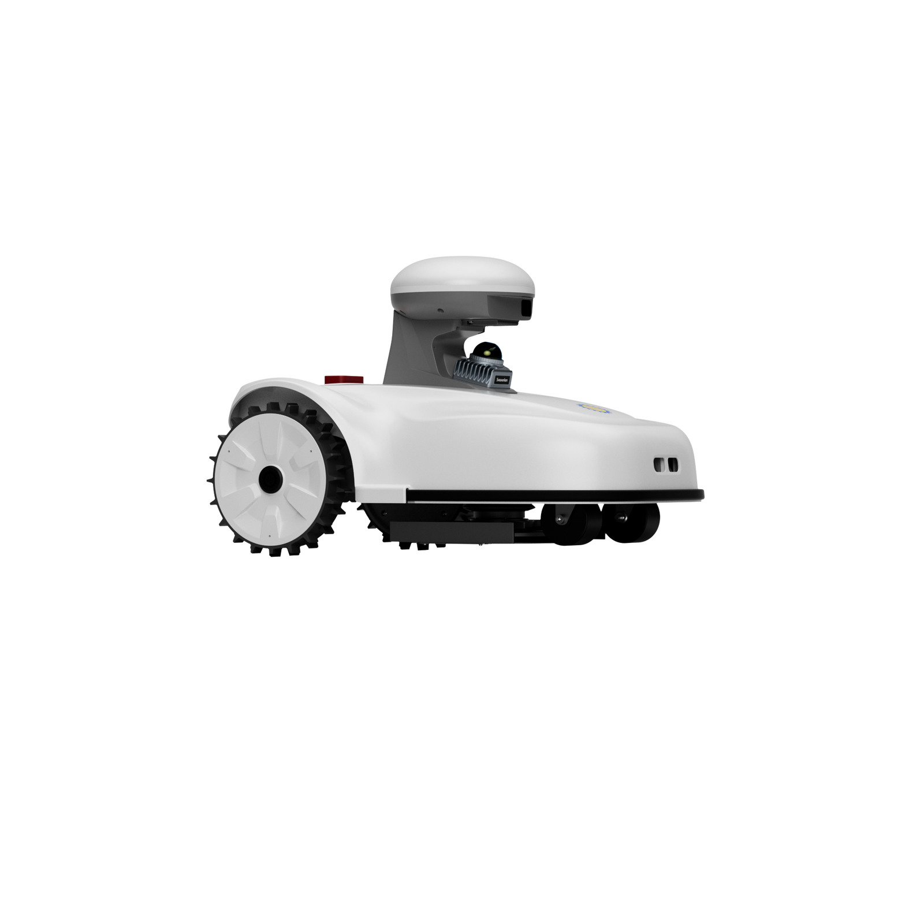
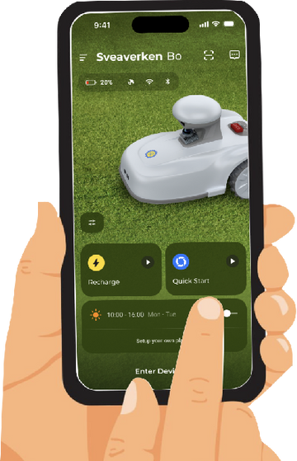
2.3.2
Connectivity Overview
1
Use the app to set up a Wi-Fi connection
Once successful, the mower will connect to the cloud
Once server info is received, the mower is online and ready to go!
2
3
Cloud
18

Slide 19
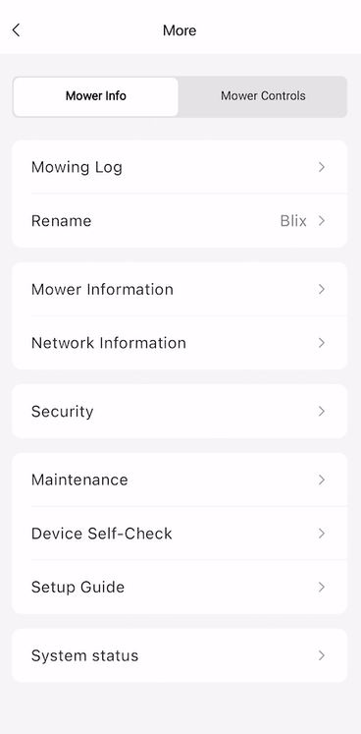
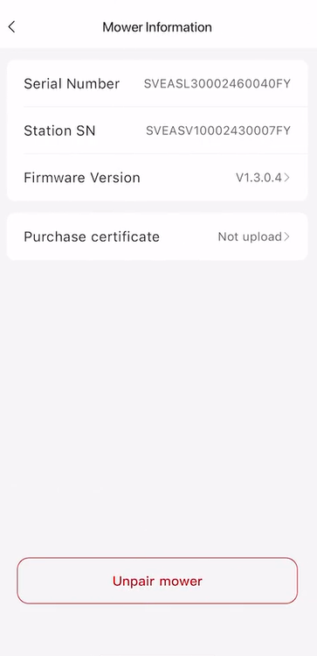
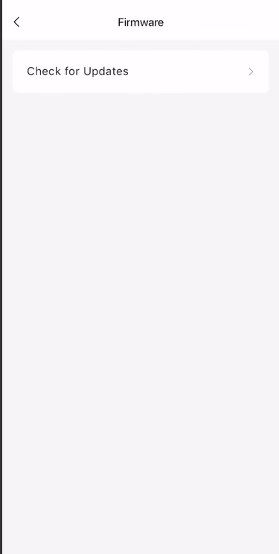
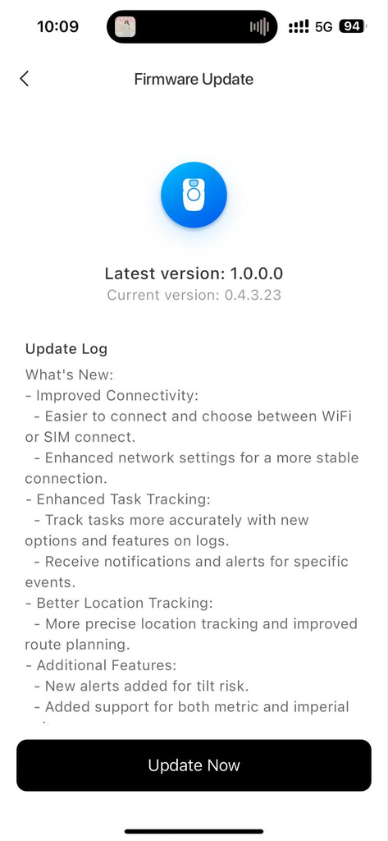
2.4 Firmware Update
0000000
*Please make sure the app and firmware are updated to the latest version before use.
19

Slide 20
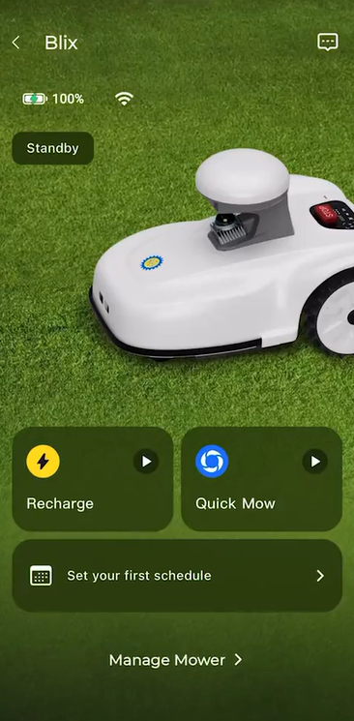
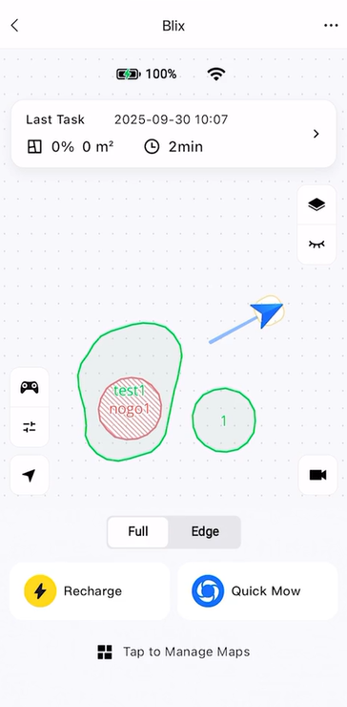
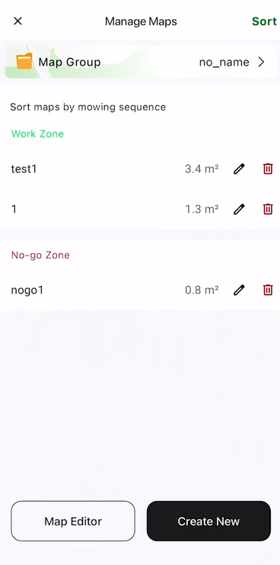
3. Map
Your
Yard
20
Notes:
Forget about perimeter wires. With Blix, we use the app to map. Simply use your phone to drive the mower along the edge of your lawn to create a Work Zone.

Slide 21
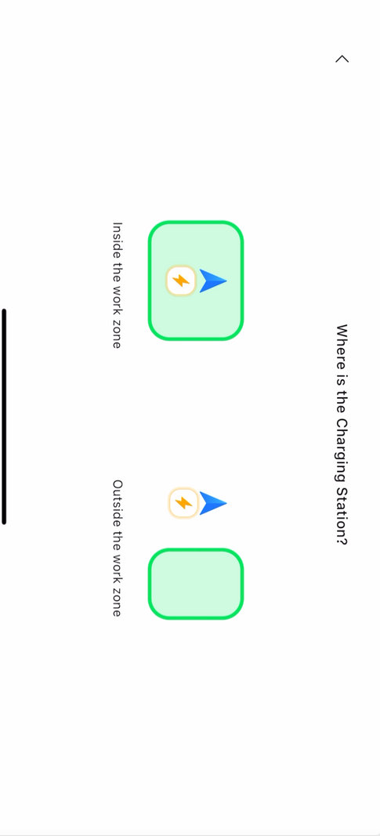


3.1 Create a Passage
1
Drive the mower to the edge of the work zone, then tap Next
3
2
Mower leaving the charging station
21
Notes:
If the charging station is outside the grass area, you can create a 'Passage' by driving Blix from the station to the zone.

Slide 22




3.2 Map a Work Zone
1
Drive along the edge of the zone
2
Change mower speed
3
If you make a mistake, tap and hold to erase
4
Complete and name the work zone
22

Slide 23

3.2 Create a Work Zone
without a Passage
Select “Inside the work zone” and follow the same process to drive the mower around the work zone, then tap Completed and name it.
23

Slide 24




3.3 Create No-Go Zones
1
2
Examples of No-go Zones
Mapping the No-Go Zone
24
Notes:
For flower beds, pools, or trees, we create No-Go Zones. Just like before, drive the mower around the obstacle to mark it off. This tells Blix exactly where not to go.
禁区没有数量限制

Slide 25




3.3 Create No-Go Zones
1
2
3
4
Mapping the No-Go Zone
25

Slide 26
3.4 View
All Zones
26

Slide 27



4. Create Scheduled Tasks
Automated mowing for selected work zones
27
Notes:
Once mapped, you can set a Schedule for automated care.

Slide 28




4.1 Parameters for Scheduled Tasks
Tap on work zones to customize parameters
28
Notes:
包括基础设置和高级设置，在割草任务进行状态下只能修改行走速度、割草速度、留草高度这三个配置

Slide 29


4.2 Quick Mow
Blix
Blix
Tap on Manage Mower to choose a Work Zone. Choose zones in the order you want them mowed.
Tap Quick Mow to start a quick mission
29
Notes:
Or, use 'Quick Mow' for an immediate start. You can even select specific zones if you only want to cut the front yard today, for example.

Slide 30


4.2 Pause and End Tasks
Blix
Blix
If in the very rare case the mower can’t return on its own, tap the game console icon to manually drive the mower back.
To pause a mission, tap the pause button
Then, long-press the stop button to end a mission
Tap Recharge to return to the charging station.
30
Notes:
Full：全局割草，Edge：仅边缘割草
左列按钮：手柄下面的按钮是修改快速割草的配置，再下面的按钮是返回到割草机的定位
右列按钮：图层按钮是修改地图背景，眼睛按钮开启后可以看到连廊路线，视频按钮可以开启远程通过摄像头控制割草机

Slide 31



4.4 Mowing Logs and Messages
31
Notes:
可以在More页面看到log，在首页的消息按钮看到message

Slide 32




4.5 Turning Patterns
2
3
2
1
3
1
4
U-Turn
K-Turn
The mower performs a compact turn using minimal edge space, ideal for narrow areas and garden borders.
A wider, gentler 3-point turn that reduces lawn stress. Best when there's more space available at the edges. Recommended for delicate grass areas.
32
Notes:
Blix is smart about how it moves. It uses U-Turns for narrow areas—this is a compact turn. Alternatively, it can use K-Turns. This is a wider, 3-point turn designed to reduce stress on your lawn and protect delicate grass.

Slide 33





4.6 Settings
33
Notes:
续割：设置停止割草任务的最低电量和续割的电量，DND模式下不割草
翻车保护：设置保护限制角度，超过这个限制就会停止并发通知
防滑设置：设置防滑检测灵敏度，打滑检测触发后将停止割草并返回充电桩

Slide 34



4.6 Settings
34
Notes:
版本更新部分：
地图更新：会自动采集环境信息，环境不能变化太大，适用于草坪缓慢成长，不能突然移动障碍物（如切割掉一棵树）
连廊停障：通过雷达检测，在连廊状态下遇到障碍物会停止，直到障碍物被清除
边界割草：只割边界的草，但是跟全局割草设置参数一致

Slide 35

Thank You

Slide 36

FAQs

Slide 37



Understanding 3D LiDAR Sensors
  LiDAR (Light Detection and Ranging) sensors emit laser pulses to measure distances, renowned for their high precision and ability to capture detailed 3D data.
  Line of Sight Limitation: LiDAR cannot penetrate solid objects or dense smoke.
  Reflective Surfaces: Highly reflective materials such as glass or metal may cause multiple reflections (or "echoes"), disrupting the sensor’s localization accuracy for the robot.
Notes:
A quick technical note: Blix uses LiDAR lasers for precision. For the best accuracy, try to keep mapping missions under 30 minutes. If your yard is huge, it's better to split it into multiple zones. Blix also 'learns'—by revisiting known locations, it corrects any data errors automatically.

Slide 38

Understanding LiDAR Sensors
Limit mapping missions to under 30 minutes for optimal accuracy. If perimeter traversal is expected to exceed 30 minutes, divide the area into multiple zones.
LiDAR sensors accumulate errors over time. By having the robot revisit a known location — here, the dotted circle — you allow it to correct accumulated errors, align newly acquired data with previously captured data, and enhance mapping accuracy.

Slide 39


Notes
  Protect the charging station’s power adapter from rain and moisture — use a cover if placed outdoors, or preferably keep it indoors and connect to the charging station with a weatherproof power extension cord.
  Clean the mower biweekly to prevent mud from clogging the wheel teeth; a quick spray with a garden hose is sufficient.
  Trim the grass around the charging station and dig a shallow trench around its base to prevent overgrown grass from disrupting the mower’s navigation when it returns to recharge.
Trim grass
Clean wheels weekly when the soil is wet
Notes:
To keep Blix running smoothly, clean the wheels and chassis every two weeks. A garden hose works fine, but avoid high-pressure water. In winter, please store both the mower and the charging station indoors.

Slide 40


Recommendations
  We do not recommend mowing in the rain. The rain sensor will pause on-demand mow missions or skip scheduled ones unless overridden via the app.
  Place the Wi-Fi router close to the lawn mower, away from obstructions like walls, to ensure reliable network connectivity.
  Keep the path from the charging station to the work zones clear, and do not allow debris to accumulate — this may hinder the lawn mower’s movement.
Notes:
https://extension.umn.edu/lawn-care/mowing-practices-healthy-lawns
Finally, a few best practices: Avoid mowing in the rain. And try not to cut more than 1/3 of the grass height at once. Regarding privacy: We value your security. Blix does not upload any images or videos of your yard to the cloud—only system logs for performance monitoring.

Slide 41


Recommendations
overhanging bushes
overgrown grass
The mower is not intended for mowing tall, overgrown grass. First cut it to 50 mm, then reduce the height further.
We recommend removing no more than ⅓ of the grass height per mowing session.
Trim overhanging bushes or branches to prevent the mower from identifying them as an “obstacle”
Notes:
https://extension.umn.edu/lawn-care/mowing-practices-healthy-lawns

Slide 42
Operating environment and temperature
Beat the Heat
Position the charging station in a shaded spot to avoid prolonged direct sunlight.
Mow during the cooler parts of the day to prevent heat stress on the grass, and only when the grass is dry to avoid mower clogs.
Storage Tips
When not in use, thoroughly clean the mower with a dry brush and wipe away debris. Do not use pressurized water, as it may damage the unit.
  Store both the mower and charging station indoors during winter.
Notes:
https://extension.umn.edu/lawn-care/mowing-practices-healthy-lawns

Slide 43

Software Setup_Beta APP
What permissions are required?
  Location, Bluetooth & Storage
  What connectivity is required?
  Bluetooth: Transforms your phone into a remote controller for the robot.
  WiFi (2.4GHz): Enables scheduling of automated mowing tasks.
  Will any of my data be accessible by Sveaverken?
  Certain data is included in system logs to help Sveaverken enhance performance and troubleshoot issues.
  Cloud-uploaded logs include the following data:
  Shape and size of your lawn
  3D point cloud map captured by the LiDAR sensor
  Mower activity status (e.g., working, standby, moving)
  Data not accessible to Sveaverken:
  Exact location (coordinates) of your lawn/yard
  Any images or videos of your yard

Slide 44
Connectivity
  WiFi: 2.4GHz
  SIM card
    Activate the SIM card in a cell phone first before using on the mower.
    Data transmitted: around 0.5 MB per day
    The following frequency bandwidths are supported
LTE-FDD | B1/3/5/7/8/20
LTE-TDD | B38/40/41
WCDMA | B1/5/8
GSM/EDGE | B3/8

Slide 45

Ideal lawn conditions for testing
  Wi-Fi Coverage: Full WiFi coverage across the yard is ideal for receiving real-time location updates during mowing missions.
  Size: 1000–3000 ㎡. This range helps test the mower’s daily mowing capacity. With a LiDAR sensor range of approximately 40 m (paired with a vision sensor), the robot performs best on mid-to-large-sized lawns.
  Multiple Zones: E.g., front and back yards connected by a pathway, or lawn sections divided by a driveway. This setup tests the robot’s autonomous navigation and ability to complete mowing missions independently.
  Slope: A section of the lawn with a slope (maximum 35°/70%). While the mower is engineered to handle inclinations of ~33°/65%, this tests its performance at the upper limit.
  Lawn Objects & Free-Roaming Pets: E.g., trampolines, playhouses, swing sets, kiddie pools, raised flower beds. This tests the robot’s ability to navigate around obstacles and resume mowing seamlessly.
Notes:
solar power panels as the weather shield - around 75-80 watts, 3-4 hours to full charge. Your thoughts?

Slide 46
What should I test for?
1. Is it easy to set up the mower for lawn mowing?
2. How well does the mower perform? How does it compare to your previous mowing equipment?
3. What do you like or dislike about any aspect of the user experience?
4. We have many app improvements planned for the coming months, but we welcome all feedback in the meantime.
5. What additional functions or features would you like to see added?
6. Do you have any other feedback or suggestions?
Fill out Survey
Notes:
solar power panels as the weather shield - around 75-80 watts, 3-4 hours to full charge. Your thoughts?

